Slide 1
The LiiNK Project:
A School Recess Intervention Promoting Healthy, Whole Child Development
Dr. Deborah J Rhea, Texas Christian University

Slide 2
Our mission is to bridge the gap between academics and social, emotional, and healthy well-being of children and adolescents. We develop the whole child through 60 minutes of recess and 15-minute character development lessons daily

Slide 3
LiiNK Project Intervention
Four – 15 minute recesses daily
Unstructured, outdoor play
Two before lunch
Two after lunch
45-60 min apart
15-20 minute lessons daily
positiveaction.net
#1 What Works Clearinghouse
Social-Emotional Learning component
Cognitive component
Developmentally appropriate

Slide 4
LiiNK History
Began in 2014
Three states: Texas, Oklahoma, & Michigan
12 school districts; 50 schools
Grades K-12 – different settings; different grade spans
Longitudinal data

Slide 5
Symposium Purpose
To present a group of studies collected from the intervention over the past year focused on obesity, physical activity trends, stress assessed through hair cortisol, motor competence/postural balance, and the use of the dominant and non-dominant sides of the body.
Each of these studies has collected a random sample of the intervention students (60 minutes of recess daily) and matching control students (30 minutes of recess daily) from grades two through five at pre and post times in the school year.

Slide 6
Symposium Speakers and Schedule
Dr. Dave Farbo – Cook Children’s Hospital
The power of outdoor, unstructured play on decreasing obesity rates and increasing physical activity in elementary aged children
Kate Webb – PhD in Health Sciences Program
The impact of multiple recesses on limb-movement patterns to strengthen cognition
Daryl Campbell-Pierre – PhD in Health Sciences Program
Körperkoordinationstest fur Kinder (KTK): Assessing motor coordination differences in children receiving varying minutes of recess daily
Dr. Debbie Rhea - The TCU LiiNK Project Creator & Director
The impact of unstructured, outdoor play on stress levels in children

Slide 7
The effects of outdoor, unstructured play on physical activity and obesity in children
Dr. David Farbo, Cook Children’s Hospital, Fort Worth, TX
Dr. Deborah J Rhea, Texas Christian University, Fort Worth, TX

Slide 8
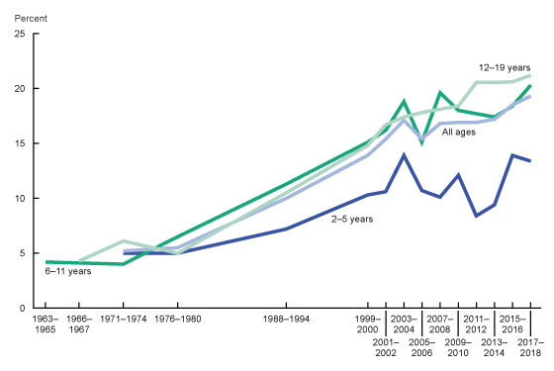
Current State of Childhood Obesity
340 million children worldwide 5-19 overweight or obese
36% in United states
Leads to:
Diabetes
Cardiovascular disease
Low self-esteem/quality of life
Depression
Anxiety
14 billion spent annually
(CDC, 2021; Sanyalu et al., 2019; Tremmel et al., 2017; WHO, 2021)
Notes:
Leading health concern of this generation of children
Steadily increasing over last 30 years
Obese children will become obese adolescents and adults (Simmonds et al., 2016)

Slide 9
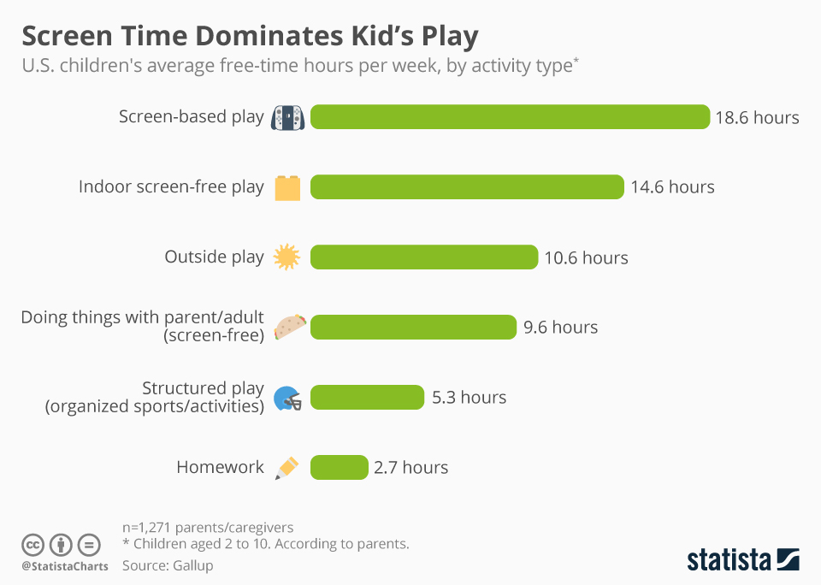
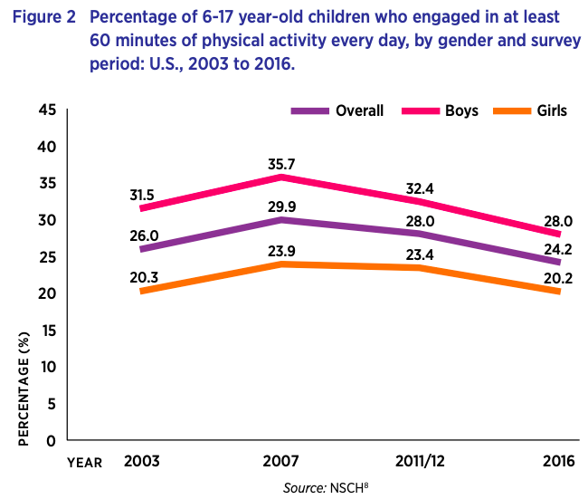
Causes of Obesity
Sedentary behaviors
Average >8 hours per day
34-39% average less than 2 hours screen time daily
63% of school day seated in classroom
Sedentary while at home
Physical activity
24-33% meeting 60 minutes of moderate to vigorous physical activity
Females less active than males
Differences by race
Physical activity decreases with age
(Aubert et al., 2018; Barnett et al., 2018; Mann et al., 2017)
Notes:
Sedentary behvaiors and lack of physical activity at all time highs
Technology is a huge issue with the health of children
Also sedentary in school
Females
Race
Physical activity will peak at age 7 and then continue to increase

Slide 10
Physical activity at school
School Environment
Emphasis on core subjects
Standardized test
More time spent in classroom=better grades
Less physical education and recess
Recess is “reward”
Taken away as punishment
Most provide only 20 minutes or less
School Interventions
Only provide up to 30 minutes
60 minutes “tipping point” for BMI decrease
Unstructured play is control group
2 or less breaks
Shorter, more frequent breaks increase MVPA at higher rate
Implementation length <6 months
>6 months have more success
(Dickey et al., 2016; Jarrett, 2019; Mitchell, 2019, Sijtsma et al., 2015)
Notes:
With all the other life stressors at home physical activity is often put on the back burner
School is focused on academics, PE and recess basically viewed as a break for them in the classroom, not important piece of the school day
Us as researchers are trying to reverse trends, try interventions in both environments
Home interventions are not success because it is difficult to find strategies that address a wide variety of children
School presents an equal playing field in which we can reach a wide range of children across many different location and cultures

Slide 11
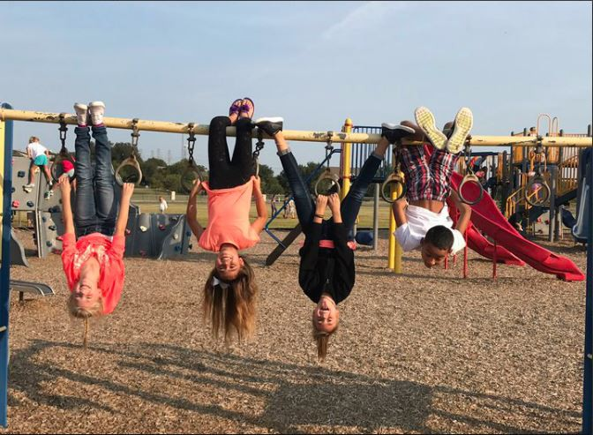
LiiNK:
45-60 minutes for outdoor, unstructured play daily
3 or 4-15 minute breaks
Beginning in kindergarten
15-minute Positive Action character lessons daily
Control:
30-minutes recess daily
No character lessons daily
Notes:
Mention here that recess and unstructured play will be used interchangeably

Slide 12
Research Question 1 and Hypothesis
RQ1:Are there differences in steps and MVPA between 3rd and 4th grade children who receive 30, 45, or 60 recess minutes
H1: Children with 45 or 60 minutes will have higher steps and MVPA than those with 30 minutes by sex and grade

Slide 13
Research Question 2 and Hypothesis
RQ2: What are the effects of 30, 45, or 60 recess minutes on obesity rates in 3rd and 4th grade children
H2: Children with 45 or 60 minutes will have a greater decrease in overweight/obese than 30 minutes by sex and grade

Slide 14
Measures-Physical Activity
Actigraph wGT3X-BT
Measures vertical, horizontal, and perpendicular orientation
Determines steps, minutes in sedentary, light, moderate, and vigorous physical activity
Non-dominant wrist
Worn for 2 weeks
Notes:
Based on previous assessment tool that we used we wanted to stay consistent
Worn on their non dominant wrist
For two weeks

Slide 15
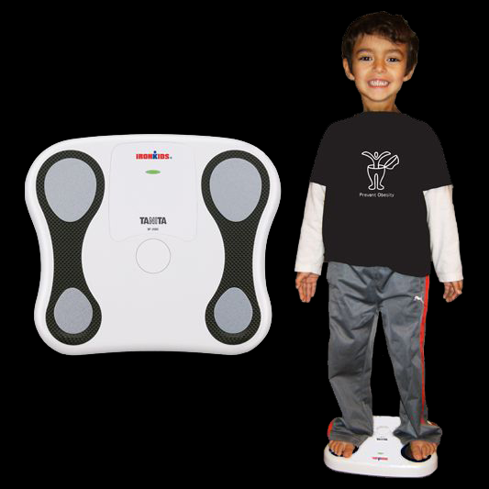
Measures-Body Composition
Tanita BF 2000 BIA scale
Valid and reliable for ages 5-17
Socks and shoes removed
~10-15 seconds
Blinded results
Body fat percentage, fat mass, fat free mass, BMI
Kabiri et al., 2015
Notes:
Tanita bf 2000
Socks and shoes removed was a bigger issue than expected. Been doing this for 3 years now, Tuesday we were in a PE office and Candice was basically gaging at the smell of kindergartens feet, I honestly didn’t notice it one bit
It did become a problem with some children as they were not comfortable taking off their socks, learned that its best to pull by gender to eliminate that issue
Also loved that it blinded results from children, prevented any awkard situations and children had no clue what they were compared to their peers

Slide 16
Results-Physical Activity-3rd Grade
***=p<.001

Slide 17
Results-Physical Activity-4th Grade
**p<.01, *=p<.05
Notes:
Explain limitations
Also that it is alarming that they are decreasing significantly compared to 3rd

Slide 18
Results-Obesity Prevalence and BF%

Slide 19
Results-Obesity Prevalence and BF%
Notes:
Could have 2 explanations
Longitudinal intervention effects
Outside variables that could cuase this

Slide 20
Summary
3rd grade
60 > 30 in decreasing obesity rates and BF%
60 > 30 in MVPA and steps
4th grade
45 > 30 in decreasing BF%
30 > 45 in MVPA and steps
School design
Recess location
PE schedule
Activity Choices
10-minute increase in MVPA
11.9x to be healthy than obese
12.5x to be overfat than obese
Both groups meeting MVPA recommendations in school alone
~83-129 minutes daily
Play environment
Age and Sex
Notes:
60 minute group benefited the most from the increase in recess
4th grade had some conflicting issues
If 4th grade group had full 60 minutes, will have similar results as 3rd grade
Model bad fit for the model
Both groups getting more than the recommended 60 during school alone
Play environment had a huge influence on the types of activities children engaged in, especially in older children and females

Slide 21
Conclusions
Additional time for outdoor, unstructured play is needed in multiple settings
Before/During/After School, child care centers, etc.
Recess is no longer a “reward”
Part of development
State and national mandates for recess
Invest in healthy future of children
Investment of outdoor play spaces
Notes:
Not only do schools need it, but everyone does
Recess needs to be viewed as an essential part of the school day
Need mandates for recess time
Need to start taking the health of children more seriously

Slide 22
QUESTIONS?

Slide 23
The Impact of Multiple Recesses on Limb Movement Patterns
Kate Webb, M.S.
Dr. Deborah Rhea
Texas Christian University

Slide 24
Introduction
Growing trend: sitting longer for content, playing less
Post-COVID: exasperated time in the classroom & 20 minutes or less of outdoor play daily
Cognition may be compromised due to inactivity trends
Utilizing limb movements can improve time on task, attention spans, processing speeds and focus.
Stimulation/Development Cerebellum, Prefrontal Cortex, Corpus Callosum
Decreased stress and depression
Purpose
An exploratory study to determine which limb movement types are utilized in varying amounts of recess (unstructured outdoor play)
This Photo by Unknown Author is licensed under CC BY

Slide 25
Research Question: Will intervention (LiiNK) schools (60 min of recess) and control schools (20 minutes of recess) vary in limb movements during unstructured play?
Hypothesis:
It is expected the LiiNK group will exhibit more limb movements than the control group.

Slide 26
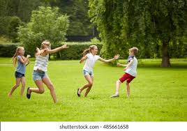
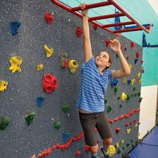
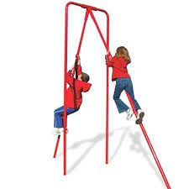
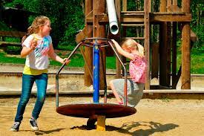
Unilateral
Movement Patterns

Slide 27
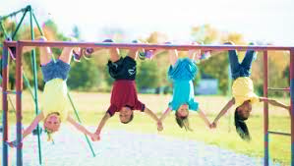
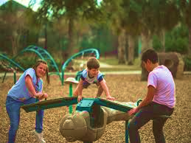
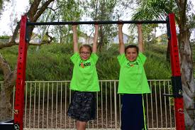
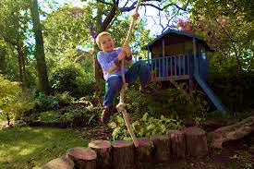
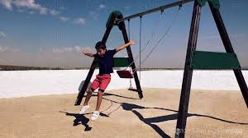
Movement Patterns
Bilateral

Slide 28
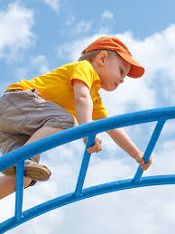
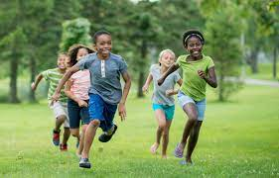
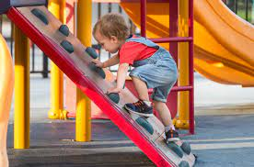
Movement Patterns
Contralateral

Slide 29
Participants by Group, Grade, & Sex
AASP Conference Fort Worth, TX 2022
Notes:
Both Male and Female were captured very well.

Slide 30
Procedures
Research
fundamental movements
Aid in brain development
Observations:
type/frequency of movements
Creation of
Movement Pattern
Observation Form
3 Minute Scan
Snap Shot Style (+/- 20 sec)
IRB approval
Translated observed activities to Movement Patterns
Specific Scan Order
Unilateral, Bilateral, Contralateral
Reliability of Form
Increase Lifetime Activity
Permission Granted, Teachers made aware
No form to capture to limb movements in play
Notes:
Reliability is a very important aspect. So each step of the form, I would take other individuals out to make sure we were seeing the same thing. At each stage of the form it was reliant across observations. Therefore we had 2 big difference in form as we came to the final product. the main issue we wanted to face first to make sure the form was going to
Mastering or participating in FMS are shown to increase both activity levels now and for lifetime activity, countering inactivity and aiding in brain neuro pathway development and stimulation. So, what basic movements are required for FMS, and to what degree are they seen in Unstructured Play?
Creation of Movement – reliability – this is where you will talk about Dave & Daryl?

Slide 31
M.P.O.T.
2 x 4 minute scans
”Snap-Shot” Scan
(+/- 20 sec)
Equipment Structures
Area Around Equipment Structures
Open Field Areas
Swing Sets
Notes:
Lower Bias / Raise Reliability
3 Minute Scan
Snap Shot Style (+/- 5 sec)
Order: Structures, area around structures, open field, swing sets

Slide 32
If given the chance to play….
Elementary children will move in ways that are essential for proper body and brain development.

Slide 33
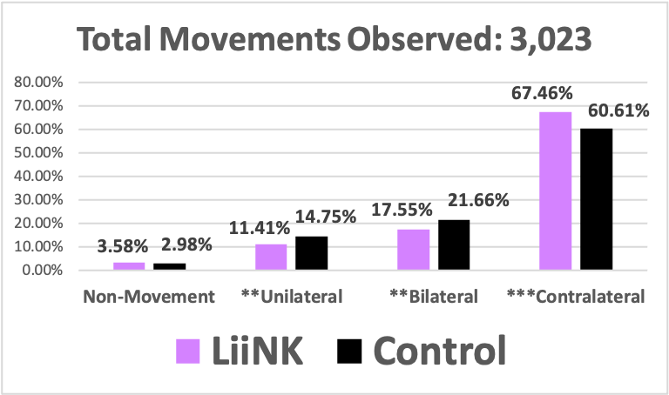
RESULTS
*
*
*p = 0.05, **p < 0.01, ***p < 0.001
Notes:
*P = 0.05, **P < 0.01, ***P< 0.001
Non: P= 0.3594
Uni: P= 0.0069
Bi: P= 0.0047
Contra: P= 0.00009

Slide 34
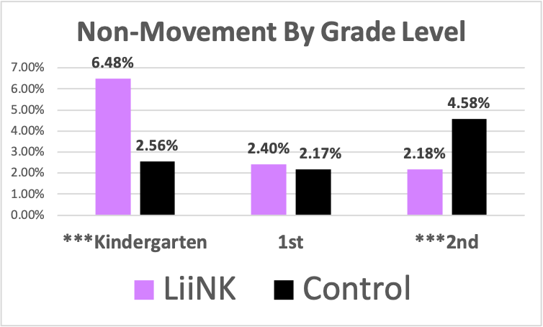
RESULTS
*p = 0.05, **p < 0.01, ***p < 0.001
Notes:
K: P= 0.000001
1st: P= 0.6727
2nd P= .0002

Slide 35
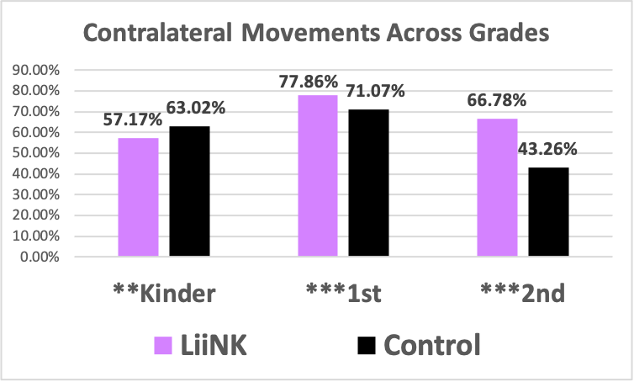
RESULTS
*p = 0.05, **p < 0.01, ***p< 0.001
Notes:
Kinder: P= .0011
1st: P= .00002
2nd: P= .000001

Slide 36
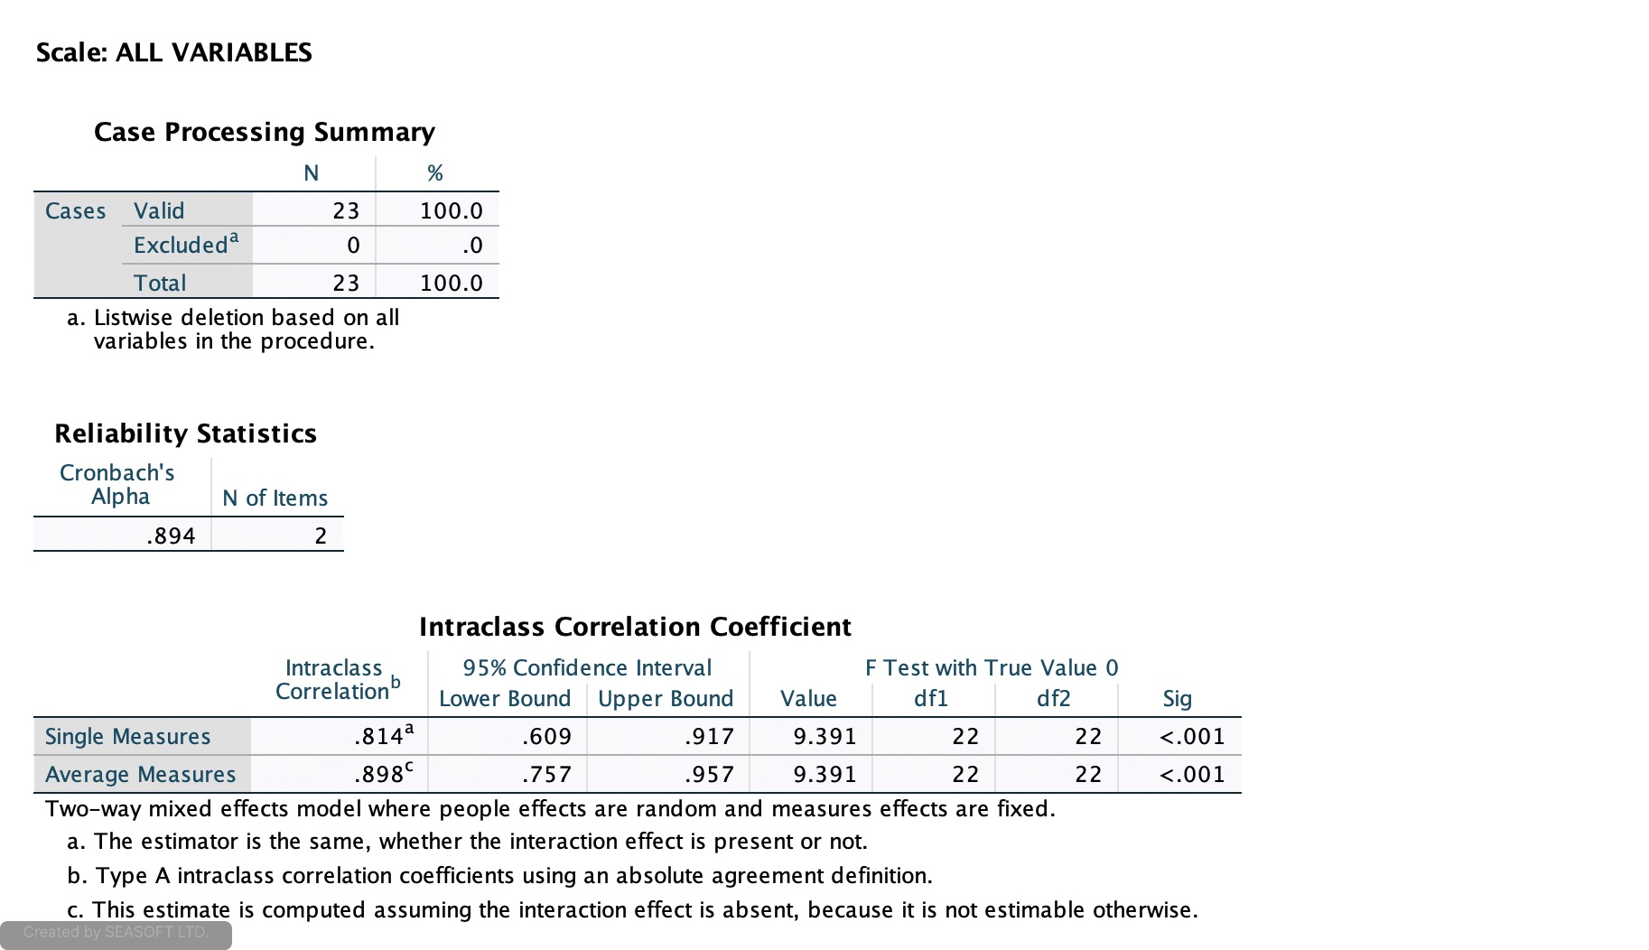
MPOT Inter-Rater Reliability Good-approaching Excellent

Slide 37
CONCLUSIONS:
Contralateral:
Most utilized = cognitive implications: focus, attention, processing speeds, time on task)
Increased with age in LiiNK schools
Kindergarten Non-Movement: Exploratory Phase
Increased activity trends with age: Intervention
Overall, 96% of students observed utilized limb movements
MPOT is Reliable
60 minutes of recess engages older children in limb movements while 20 minutes of recess engages older children less in limb movements
Notes:
Kindergarten intervention non-movement numbers may be accounted for due time to discover/explore environment with more play time scheduled
Unstructured play trends as a viable means for movement
Of the 2,923 observed, only 100 ”Non-Movement”
Multiple unstructured play may reverse inactivity trends as children age
Intervention students preformed significantly more contralateral movements than control students.
2nd Grade trends to more activity and more contralateral movements than control. Opposite of normal activity trends
Literature shows contralateral as most significant type of movement to improve cognition since it moves both sides of body and often crosses the mid-line.

Slide 38
What’s Next…
Continue Observations to study trends
Will the preliminary trends continue
Muscular Imbalance Testing
Do those who play more have more muscular strength/control?
Attentional Fatigue Testing or D2 Attention Test:
Will there be a relationship between muscle strength and attention/processing speed?

Slide 39
Questions?

Slide 40
An Alternative Useable Assessment to Evaluate Dynamic Postural Balance in School Aged Children
Daryl Campbell-Pierre & Dr. Debbie Rhea
Texas Christian University

Slide 41
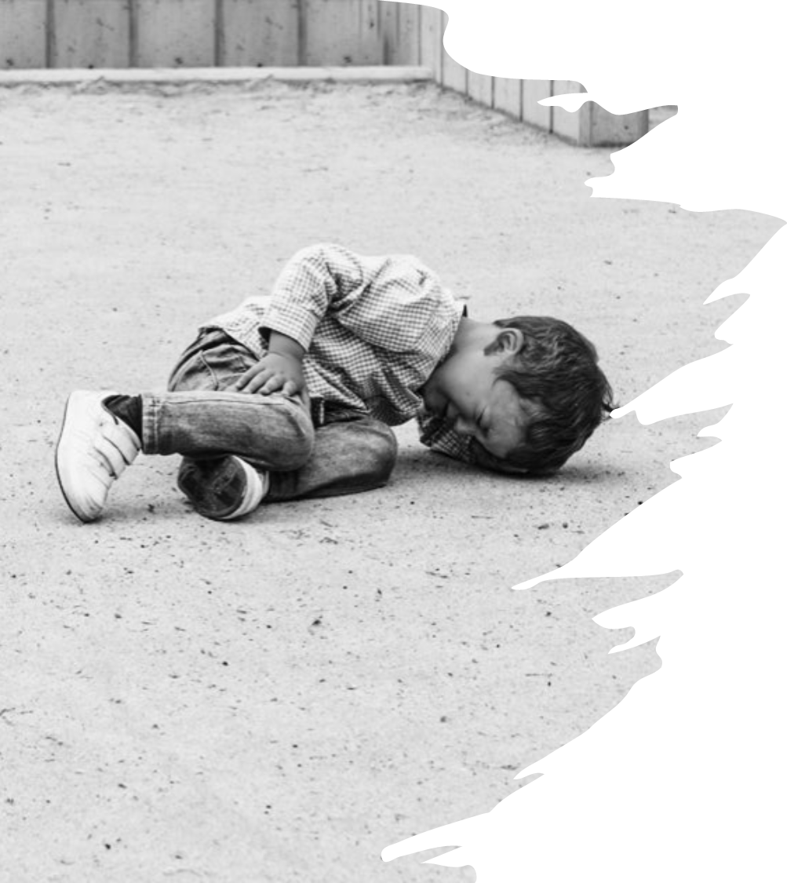
Why is Dynamic Postural Balance Important?
For the past 10 years, falls have been the leading cause of nonfatal injuries for children under the age of 15 years old.
Children are more prone to fall injuries due to motor coordination (MC) deficits.
Encouraging more physical activity / play opportunities into a child’s life.
Gross motor competence is the key to identifying a child’s dynamic postural balance abilities.

Slide 42
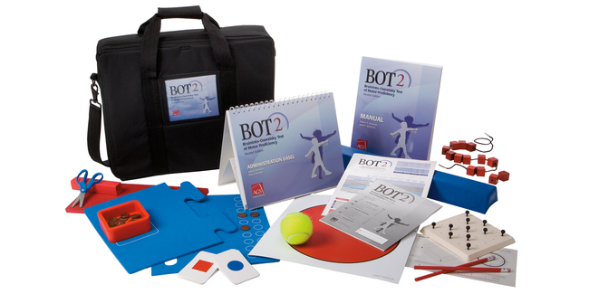
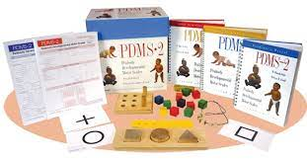
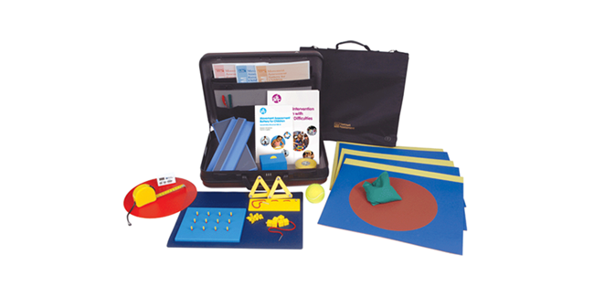
Assessing Postural Balance in Children
Three main Motor Coordination (MC) assessments frequently used in the United States:
Movement Assessment Battery for Children M-ABC Bruininks
Oseretsky test of motor proficiency (BOTMP)
Peabody Developmental Motor Scales (PDMS).
The Körperkoordinations test für Kinder (KTK) is a gross motor only assessment designed to administer typical and atypical children’s gross motor development related to dynamic postural balance.

Slide 43
Purpose of the Feasibility Study
Most motor coordination assessments in the U.S are designed to evaluate atypical children.
The KTK evaluates atypical and typically developing children.
Needed to evaluate whether the KTK can be used in U.S. physical education classes.
Translated instructions and how to score the subtests.
A scoresheet was created, equipment was developed & evaluation method was established to determine feasibility in a U.S school.

Slide 44
KTK Assessment
Examines gross motor skills in children between the ages of 5-14 years old.
A valid and reliable assessment tool in other countries.
Each subtest evaluates balance, rhythm, strength, laterality, speed, and agility.

Slide 47
LiiNK school students received:
45 minutes of outdoor, unstructured play daily
3 15-minute breaks
15-minute Positive Action character lessons daily

Slide 48
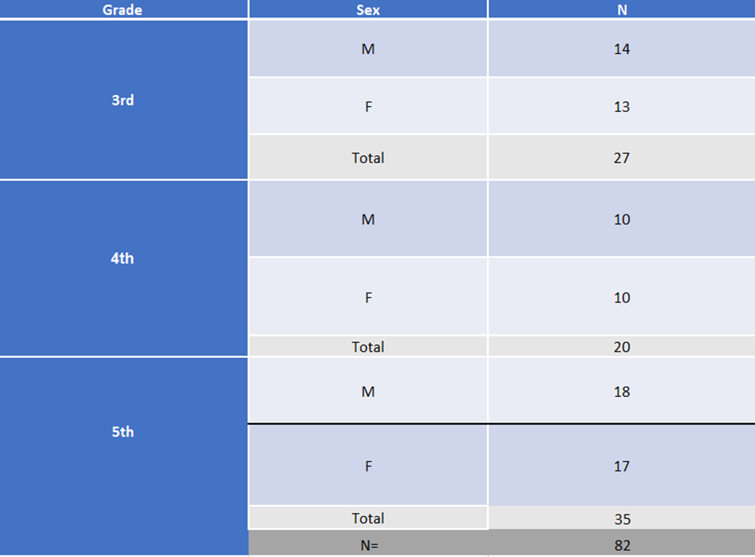
Feasibility Participants
The LiiNK research team held an adherence meeting with eight physical education teachers to go over evaluation procedures.
During the collection process, two researchers from the LiiNK Project team along with two P.E. teachers, administered the KTK to determine the feasibility of the assessment.

Slide 49
Feasibility of the KTK Assessment
The students loved participating in the KTK assessment. They were challenged but enjoyed the subtests.
The German assessment was deemed feasible to administer in a physical education class in the United States.
Physical educators were easily trained on the four KTK subtests and able to administer the assessment during P.E. classes.
All children, typical and atypical, were able to complete the subtests in the gym demonstrating that the assessment is an inclusive tool to be used in P.E. classes.
Preliminary findings in a school with multiple recesses showed males were better at lateral moves than vertical moves. Females scored higher on vertical moves than lateral moves.
An assessment tool like this may be instrumental in identifying lateral and vertical postural balance differences.
Next Step: Pilot Study
Prepare physical educators to administer the KTK for ease of use and number of days needed to administer it for different groups of children.

Slide 50
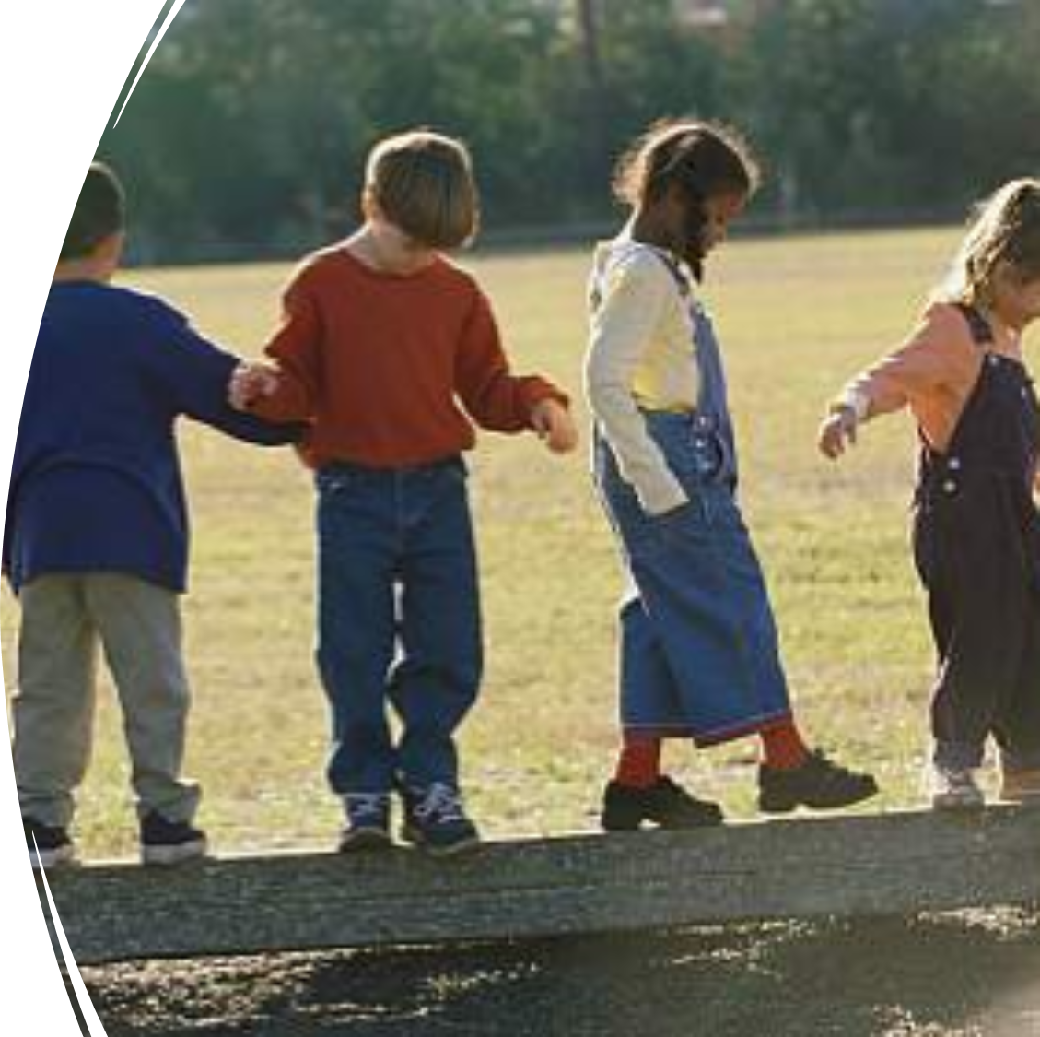
Pilot Study Purpose
The purpose of this study was to evaluate gross motor differences in 10-year-old boys and girls that attended a LiiNK intervention school verses a non-LiiNK intervention school.

Slide 51
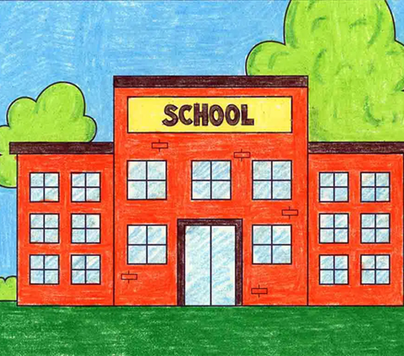
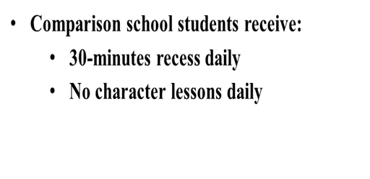
School Differences

Slide 52
Participants

Slide 53
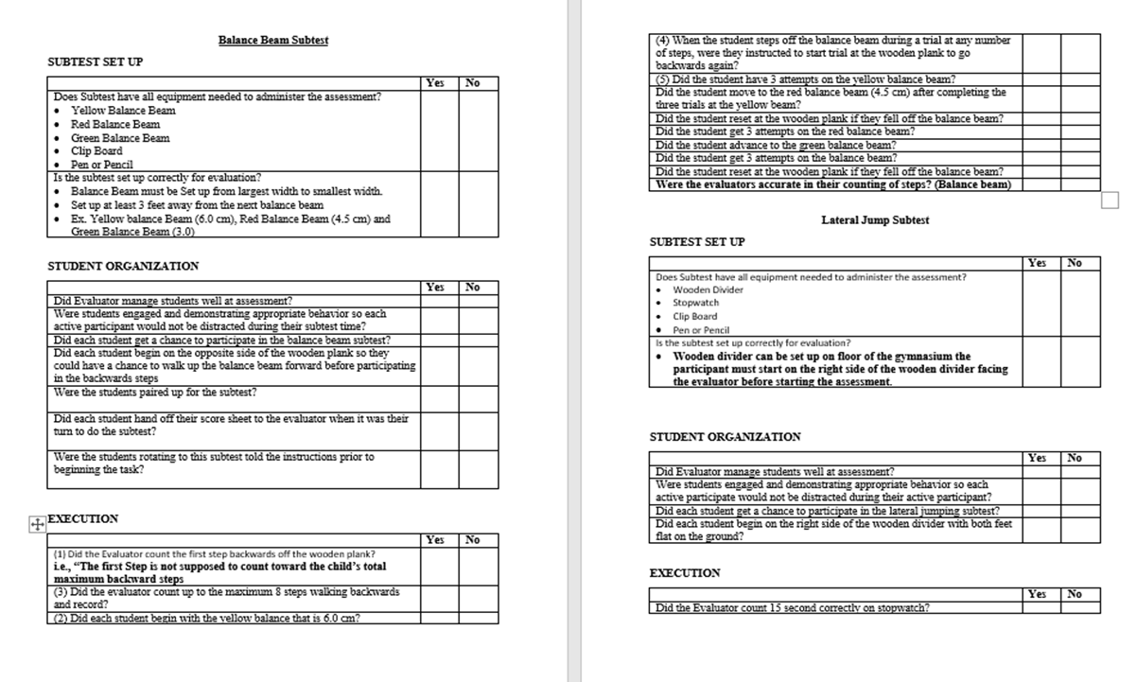
Fidelity KTK Checklist

Slide 54
Pilot Study Results

Slide 55
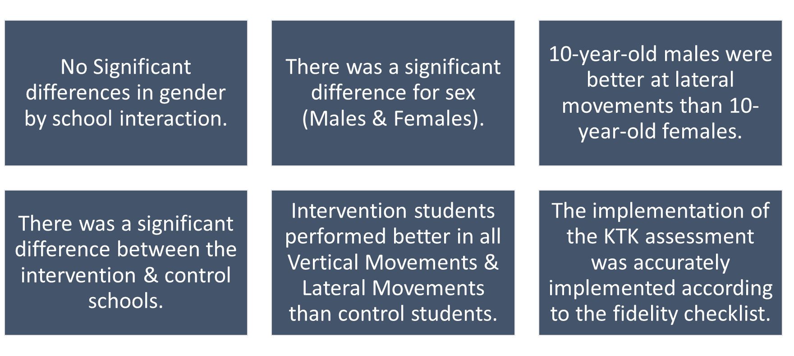
Conclusions

Slide 57
The Impact of Unstructured, Outdoor Play on Stress Levels in Children
Dr. Deborah J Rhea, Texas Christian University
Kelsey Kirby, M.S., Texas Christian University

Slide 58
STRESS IN THE CLASSROOM
Pressure for academic success
70% of students report feeling stress and anxiety
Inhibits encoding of new information
Obstructs memory retrieval
Suppresses new & past information integration
Underestimation of true knowledge
(Ahmad et al., 2016; Joëls et al., 2006; Vogel & Schwabe, 2016)

Slide 59
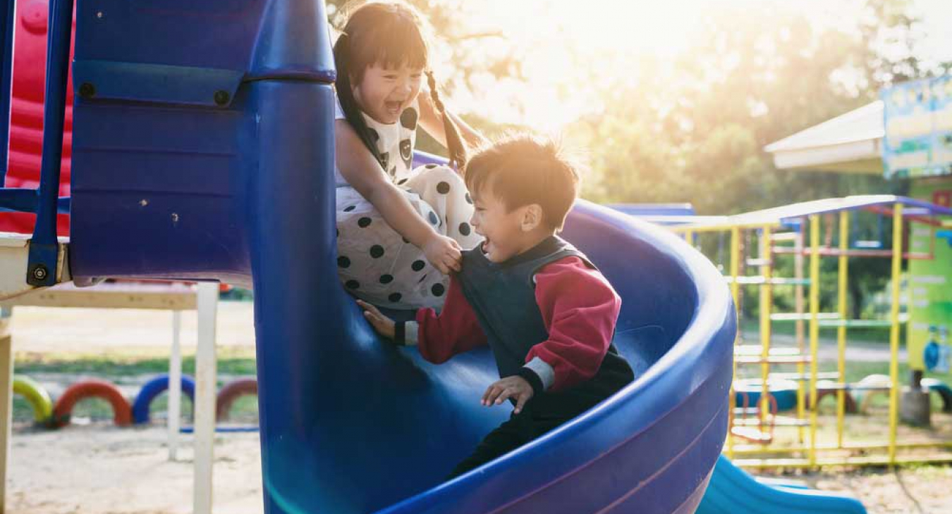
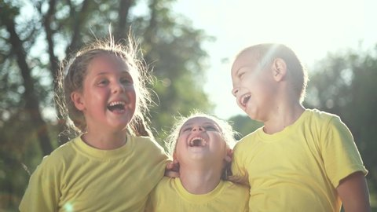
PURPOSE OF THIS STUDY
To examine the effectiveness of a multi-recess school intervention on chronic stress patterns in elementary children compared to children receiving standard recess time

Slide 60
RESEARCH QUESTION & HYPOTHESES
Research Question: Are there chronic stress differences in children with varying amounts of daily, outdoor, unstructured play?
H₁: Intervention school children will show significantly lower levels of chronic stress than the control group.
H₂: Chronic stress levels will not differ within groups by gender.

Slide 61
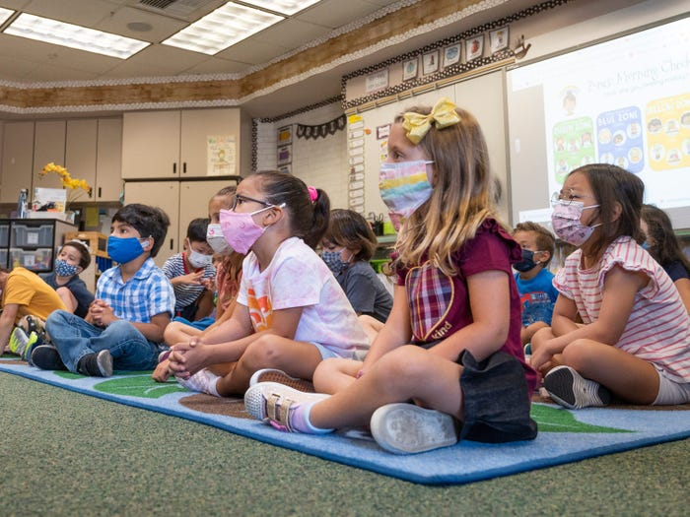
PARTICIPANTS
4th grade children from the same school district:
Intervention
3 schools
45 minutes of recess daily + PE class
Daily 15-minute Positive Action character development lesson
Control
3 Schools
30 minutes of recess daily + PE class
No character development lessons

Slide 62
MEASURE: DEMOGRAPHIC INFORMATION
Name
Date of Birth
Gender
Grade
Homeroom
** This information was used to create a deidentified profile attached to their ID#, as well as locate each child on the day of data collection.

Slide 63
MEASURE: HAIR CORTISOL CONCENTRATION
1 cm of hair growth ~ 1 month cortisol
3+ months is considered chronic concentration
3 cm from the scalp
Sample around ½ width of a pencil eraser
Hidden area on the scalp
Unnoticeable
Limited from sun exposure

Slide 64
PROCEDURES: PARTICIPANT RECRUITMENT & DEMOGRAPHICS
Recruitment:
IRB approval
School awareness of possible participation
Informed parental consent
Informed participant assent
Exclusion criteria:
Incomplete participation,
Hair shorter than 3cm in length,
Absent day of collection
Participant demographics:
After enrollment, school secretaries released class lists to The LiiNK Project including name, date of birth, gender, grade, and homeroom

Slide 65
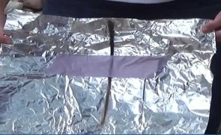
PROCEDURES: HAIR CORTISOL CONCENTRATION
Private area with child facing wall
Reinform child of procedure & confirm assent
Hair is combed & sectioned
Sample section is combed, pulled away from scalp, & twisted at the scalp
Cut as close to scalp as possible
Sample is secured on foil
Foil is folded & labeled
Foil placed in envelope
Envelope is closed, labeled, and stored for transportation

Slide 66
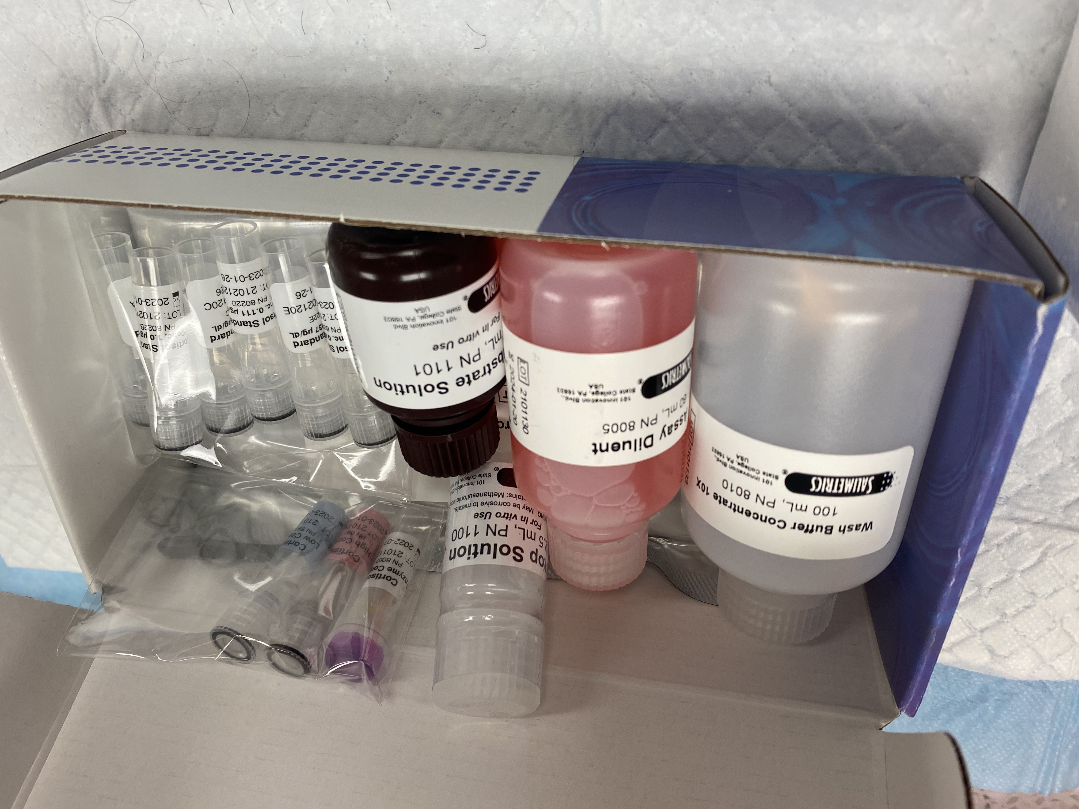
PROCEDURES: HAIR CORTISOL EXTRACTION
Washed with isopropanol
Dried for at least 48 hours
Hair pulverized in polypropylene tube with steel beads
Incubated in methanol for 24 hours
Centrifuged into pellet @ 10,000 rpm
Methanol evaporated out of tube
Using a high-sensitivity enzyme immunoassay kit, cortisol concentration is extracted & analyzed

Slide 67
RESULTS: DEMOGRAPHICS
Intervention
35 Males
29 Females
Total: 65 Children
Control
31 Males
35 Females
Total: 66 Children
9-year-olds
Intervention: 53
Control: 45
98 Total
10-year-olds
Intervention: 10
Control: 19
29 Total

Slide 68
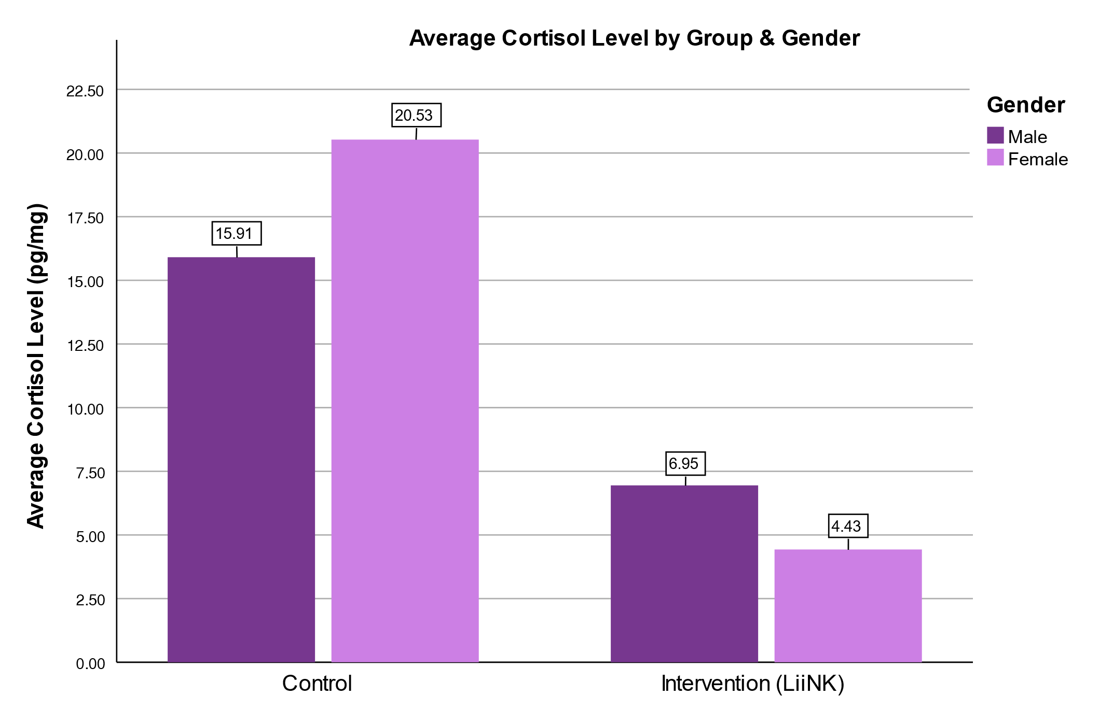
Group by Gender Differences
Are there chronic stress differences in children with varying amounts of daily, outdoor, unstructured play?
Intervention students recorded significantly lower levels of chronic stress.
t(125) = 2.37, p = .019

Slide 69
Group by Age Differences
Pre-COVID research data:
9-year-olds: 6.7 pg/mg
10-year-olds: 8.5 pg/mg
This study (Post COVID):
Significantly lower cortisol for LiiNK
9-year-olds (p = .025),
& 10-year-olds (p = .002)

Slide 70
CONCLUSIONS
Children receiving the intervention of 45 minutes or more of unstructured, outdoor play are significantly less stressed than those who receive 30 minutes or less of recess.
Adding opportunities for outdoor physical activity throughout the day better prepares children’s cognitive function for learning than increased class time
Having recess year after year at 45-60 minutes daily may be the strongest predictor of these low chronic stress levels in children

Slide 71
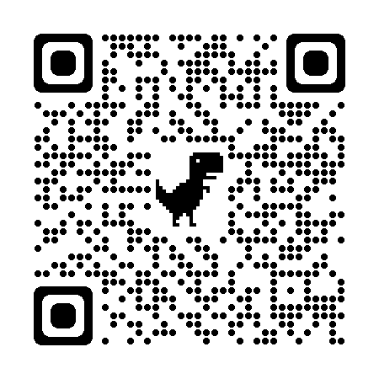
LIMITATIONS & FUTURE RESEARCH
Limitations
Hydration status of children
COVID-19 pandemic
First semester back in a classroom
Previous research from a Pre-COVID era
Future Directions
Explore other grade levels
Longitudinal study continuing to examine chronic stress
Relationship between chronic stress and somatic complaints
Relationship between chronic stress and academic performance
Stay Connected!

Slide 72
QUESTIONS?

