Slide 1
The secret sauce of a healthy life
Dr. Deborah J Rhea
Professor, Kinesiology
LiiNK Center for Healthy Play – Director
Texas Christian University

Slide 2
State of the Nation
10-20 million children and adolescents in the United States have some form of chronic illness or disability
133 million (45%) adults have at least one chronic illness
18-22% of children & adolescents are obese
69% of our nation’s adults are overweight or obese
D3 deficiencies as early as 1-6 months through older adults
Sedentary lifestyle is common in children and adults
Stress and anxiety disorders are at an all time high (31.9% in adolescents; 1 out of 7 children)
Anxiety is the most common mental disorder, affecting 40 million adults in the U.S. population
Indoors at least 6 hours per school day (9 mos of year)
Socialization is minimal
Technology addictions (37% teens; 330 million adults)

Slide 3
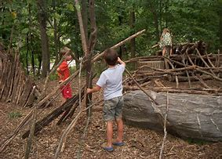
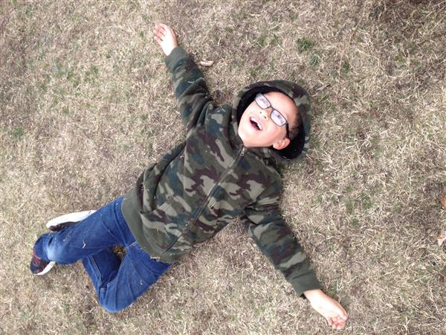
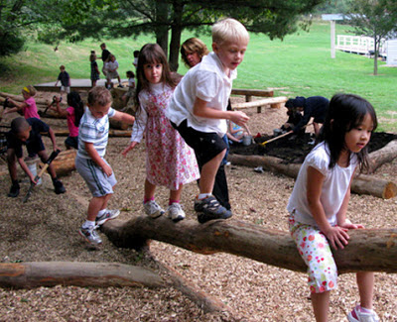
Properties of Child’s play
Purposeful
Self-directed
Voluntary
Inherent attraction
Freedom from time
Diminished consciousness of self
Improvisational potential
Continuation desire

Slide 4
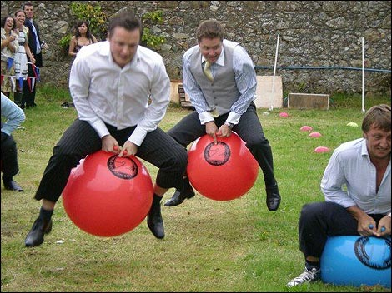
What is play to Adults?
Many adults think of structured activities
Structured play Unstructured play
Unstructured play
Intrinsically motivated
Cognitive development
Attention
Creativity
Social-emotional well being
Physical activity
Notes:
Lack of research on adult play
Hit a stage when play “is not necessary”
“Play is for children”
Not a part of daily routine
Play every day, but label it as something else
i.e. collecting toy cars is a “hobby”

Slide 5
Play Research

Slide 6
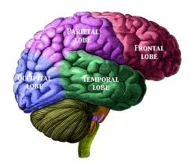
“The truth is that play seems to be one of the most advanced methods nature has invented to allow a complex brain to create itself.”
Play: How It Shapes the Brain, Opens the Imagination, and Invigorates the Soul, Stuart Brown, 2010
Notes:
Lack of research on adult play
Hit a stage when play “is not necessary”
“Play is for children”
Not a part of daily routine
Play every day, but label it as something else
i.e. collecting toy cars is a “hobby”

Slide 7
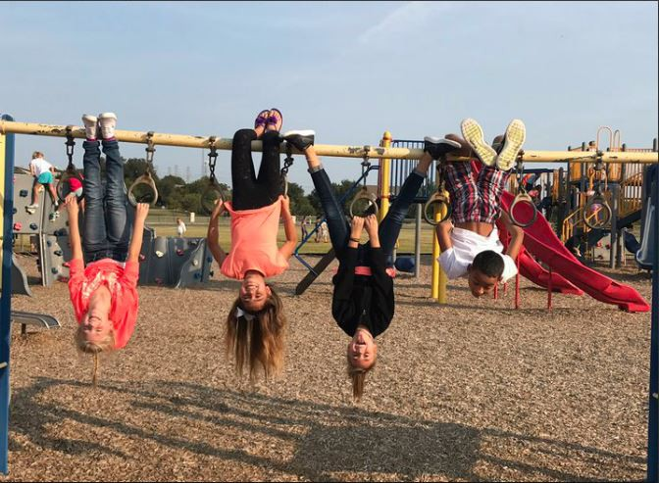
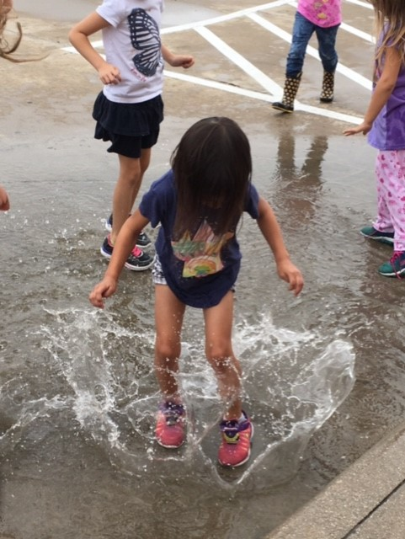
Play Promotes Self
PLAY Leads to changes in the brain at molecular (epigenetic), cellular (neuronal connectivity), and behavioral levels (socioemotional and executive functioning skills)
PLAY Promotes learning, adaptive and/or prosocial behavior
PLAY Supports improvements in executive functioning, language, early math, social development, peer relations, physical development and health, and enhanced sense of action

Slide 8
Brain development
Activity level (unstructured and structured)
Short bouts of information
Socialization
Emotional states
Notes:
DO:
[Review the four pieces that lead to healthy brain development.]
SAY:
This slide gives a visual on how we develop our brains to take in information.
There are four important areas that lead to brain development:
Activity level: how much are we moving in sport and also in play settings?
Short bouts of information given at one time: longer bouts of information are not retained very well.
Socialization: this is important from a very young age, but unfortunately, children today are not socializing the way they need to because of technology.
Emotional states: children today are more stressed, less happy, and experience more depression and anxiety than ever before. If they’re anxious or stressed, this creates a rise in cortisol which can shrink the brain.
LiiNK addresses all 4 areas:
Activity level: children still get physical education (structured) as well as four 15-minute recesses per day (unstructured).
Short bouts of information given at one time: This goes to LiiNK protocol because you have recesses every 45-60 minutes of content.
Socialization: This is important from a very young age, but unfortunately children today are not socializing the way they need to because of technology. With LiiNK breaks, children have more opportunities to socialize, and with Positive Action, they are learning how to socialize.
Emotional states: We have had graduate students look at the emotional states of children in LiiNK grades, and have found that they show more positive emotions at recess than children in non-LiiNK schools. They are not as stressed or anxious, and are happier (lower cortisol levels).

Slide 9
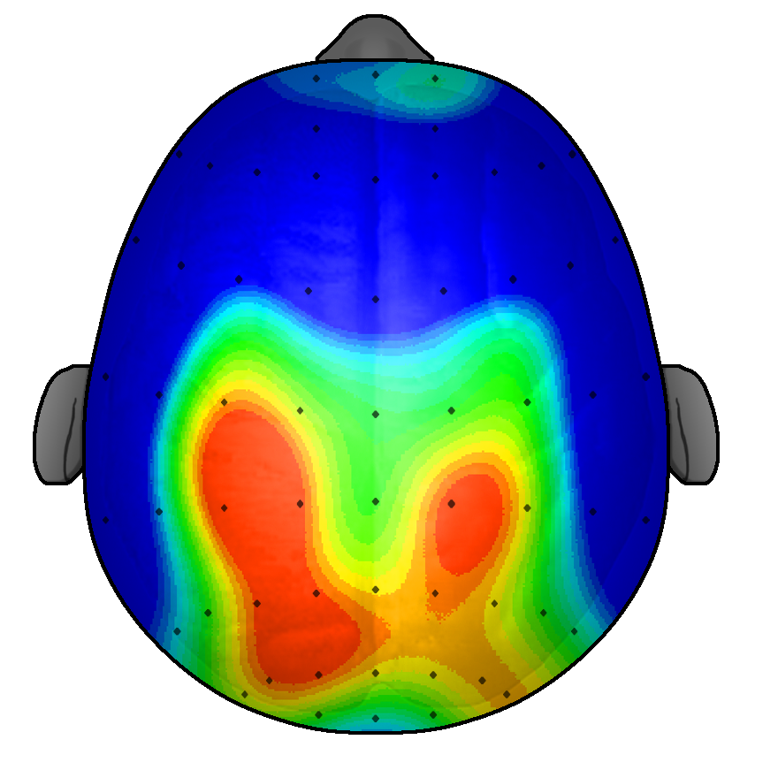
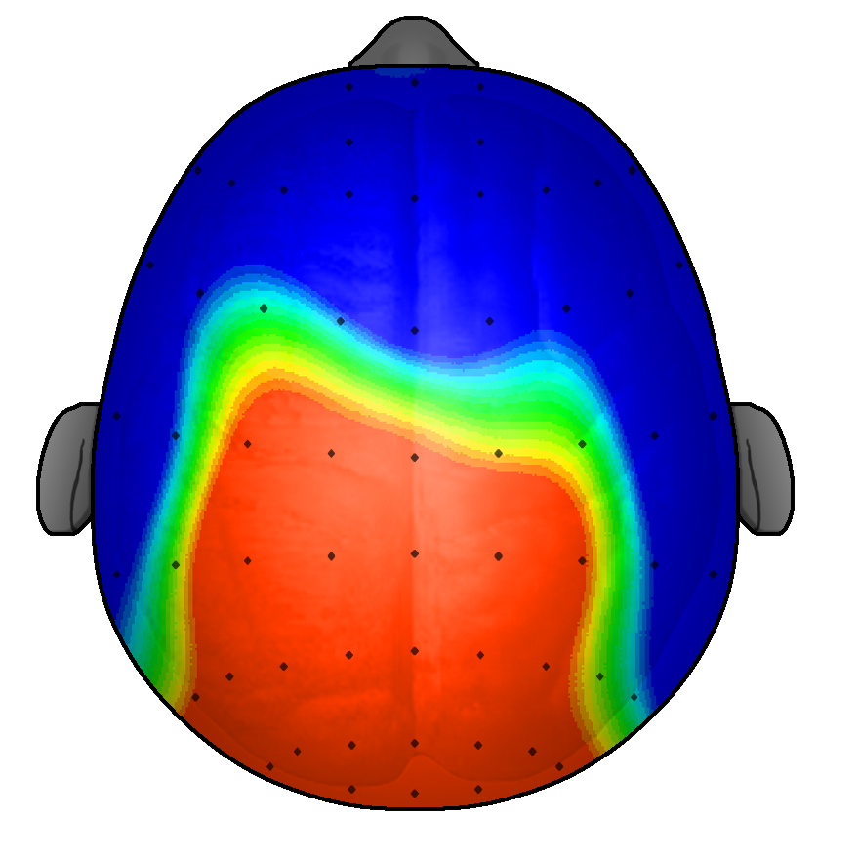
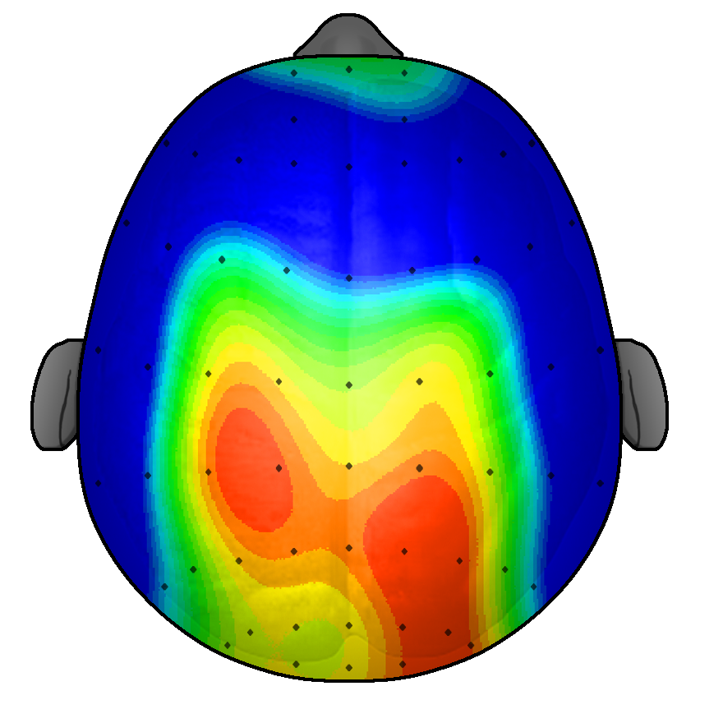
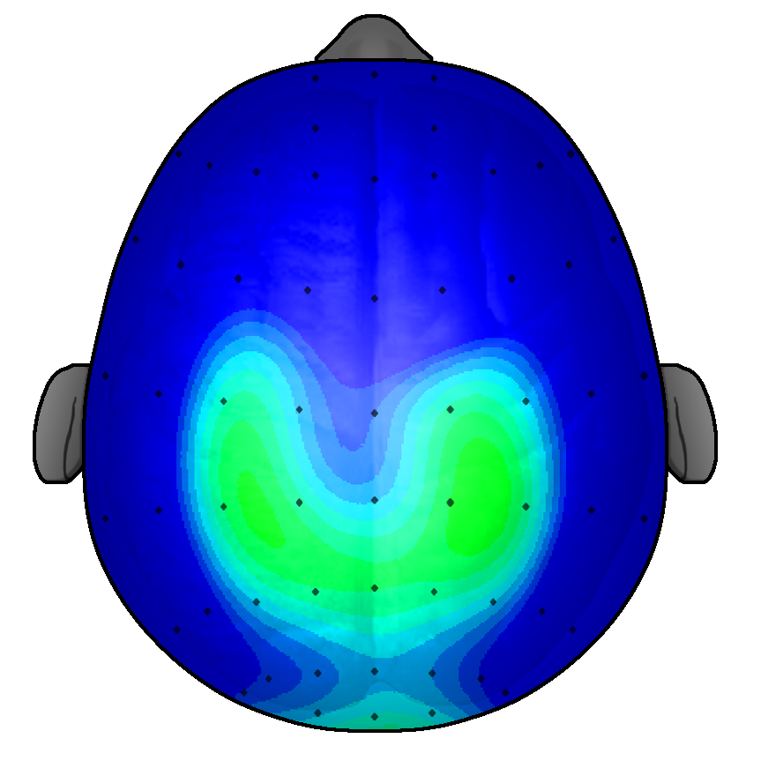
Pre-test
9 Months Later
FITKids
Intervention
Waitlist
Control
7
µV
10
Notes:
DO:
[Discuss the study shown on the slide.]
SAY:
This study (2010) examined the relation between physical activity and brain function.
50 children completed a recognition task on a computer.
Of those 50, 25 participated in a 9-month physical activity afterschool program, while 25 went home after school.
Those that participated in the afterschool program engaged in 75-minutes of physical activity each day.
Those who participated in the program improved their performance, while those who did not participate actually had lower scores
Brain function of the kids who did the after-school physical activity program is shown on the top (before and after the nine months).
Brain function of the kids who just went home and stayed indoors after school is shown on the bottom (before and after the nine months).
The color red is positive neural activation in that region of the brain (red is good).
The color blue is little or no activation in that region of the brain.
ASK:
What does our brain look like with/without physical activity?
Which kid do you want to have in your classroom?
BACKGROUND INFO:
Pontifex, M. B., , O’Leary, K. C., Raine, L. B., Chien-Ting, W., Drollette, E. S., Castelli, D. M., & Hillman, C. H. (2010). The beneficial effects of fitness training on neurocognitive function in preadolescent children. Presented at the 58th Annual Meeting of the American College of Sports Medicine, Denver, CO.

Slide 10
Get out of your chair. No, really. According to the CDC, prolonged sitting is the #1 contributor to chronic diseases, with negative effects beginning after just one hour of sedentary behavior. http://home.utilifit.com/why-utilifit/
Just one hour of sitting is as unhealthy as smoking two cigarettes. All the latest research points to a single direction… Sitting is the New Smoking.
Notes:
DO:
[Discuss the negative effects of sitting for adults and children.]
SAY:
We know that activity is good for our brains and our bodies, but what happens to our bodies without activity?
Today we are sitting more than ever, and just one hour of sitting has negative effects on your health. Knowing this, think about how long your kids are sitting and what it’s doing to them over time.
Early onset Alzheimer’s went from 60 to 50 years old. In next couple decades, it might be 40 or younger – why? Because we aren’t getting up and moving in unstructured patterns that build neurological highways in the brain. Without movement, the connections in our brains break down.
1 in 3 adolescents meet the criteria for an anxiety disorder (NPR, 2018) and 32% of teens report feelings of sadness and hopelessness. This stems from children being play-deprived because parents are so worried that something bad will happen, even though the crime rate has steadily declined over the last few decades.
BACKGROUND INFO:
https://www.npr.org/sections/ed/2018/07/18/620074926/empowering-kids-in-an-anxious-world

Slide 11
Play Emotions Dr. Peter Gray
When play is missing:
Rise in narcissism
Extrinsic control
Others directed
Lack of direction
Anxiety/stress
Internal struggles
Void of self
When play is available:
Self-controlled
Self-directed
Intrinsic control
Rise in empathy
Calm/Relaxed
Failure is part of growth
Peace with self and identity

Slide 12
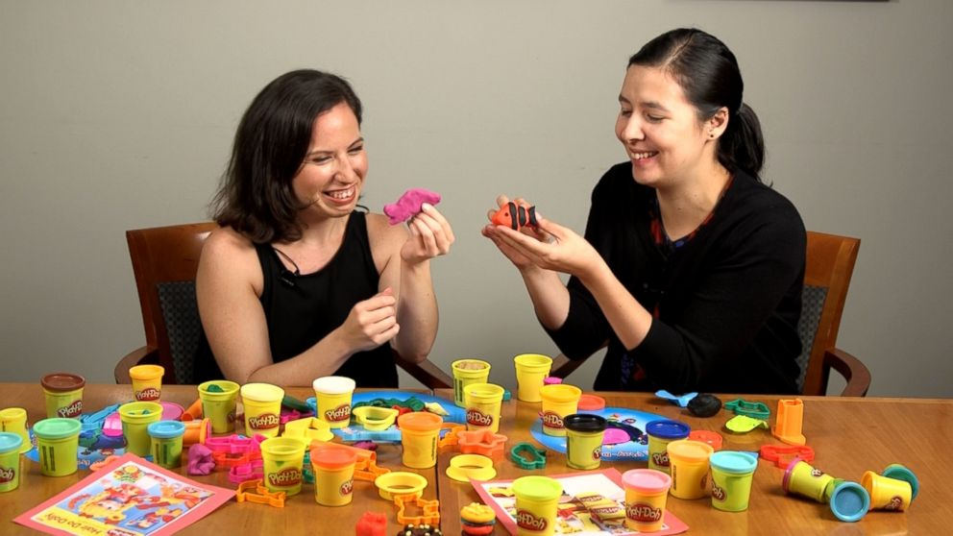
Decline of play
Baby Boomers
School
Focus on whole child
60 minutes for play
Less stress on academics
Home
Freedom
Less technology
Minimal sports
Generations to the present
School
Focus on academics
Less time for recess
Extra curriculars declining
Home
Strict rules from parents
Increase in technology
Sports, competition, and winning rules all

Slide 13
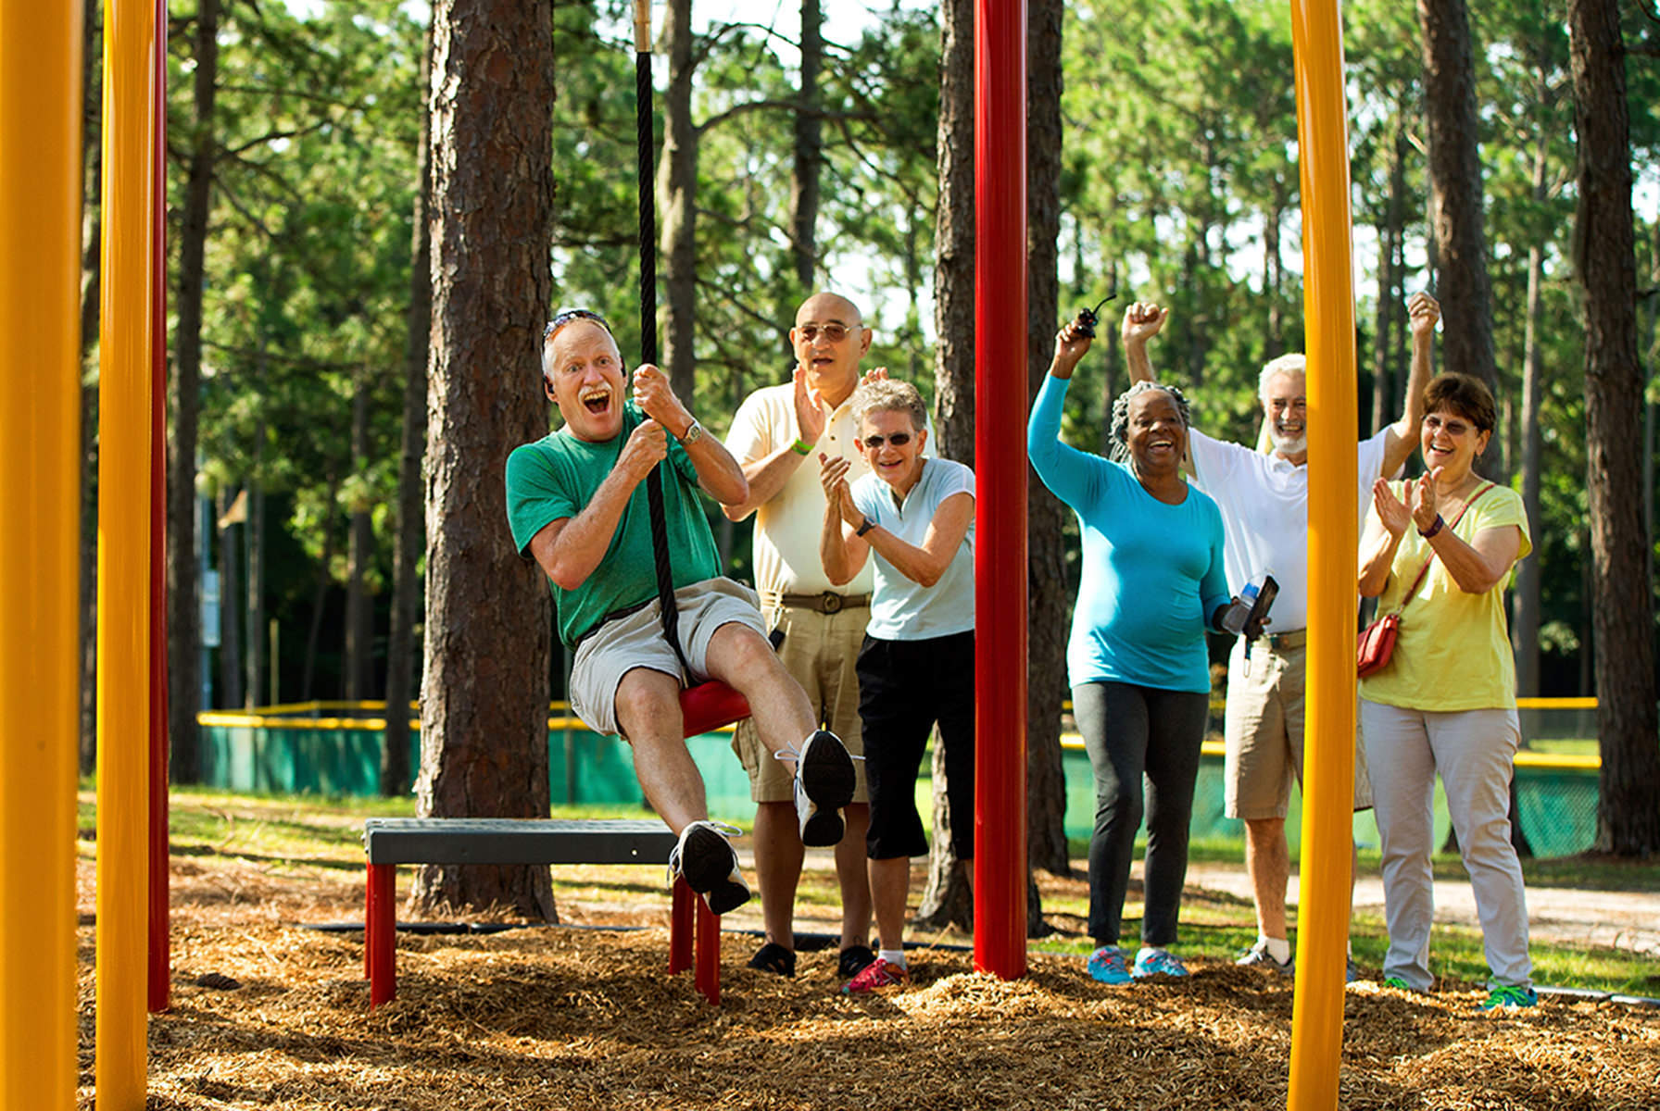
What happens When Adults don’t play?
Less active
Obesity rates rising
Lack creativity
Stress is high
No outlet to relieve stress
Always trying to act as an “adult”
Quality of life decreases
No chance to “get away from it all”

Slide 14
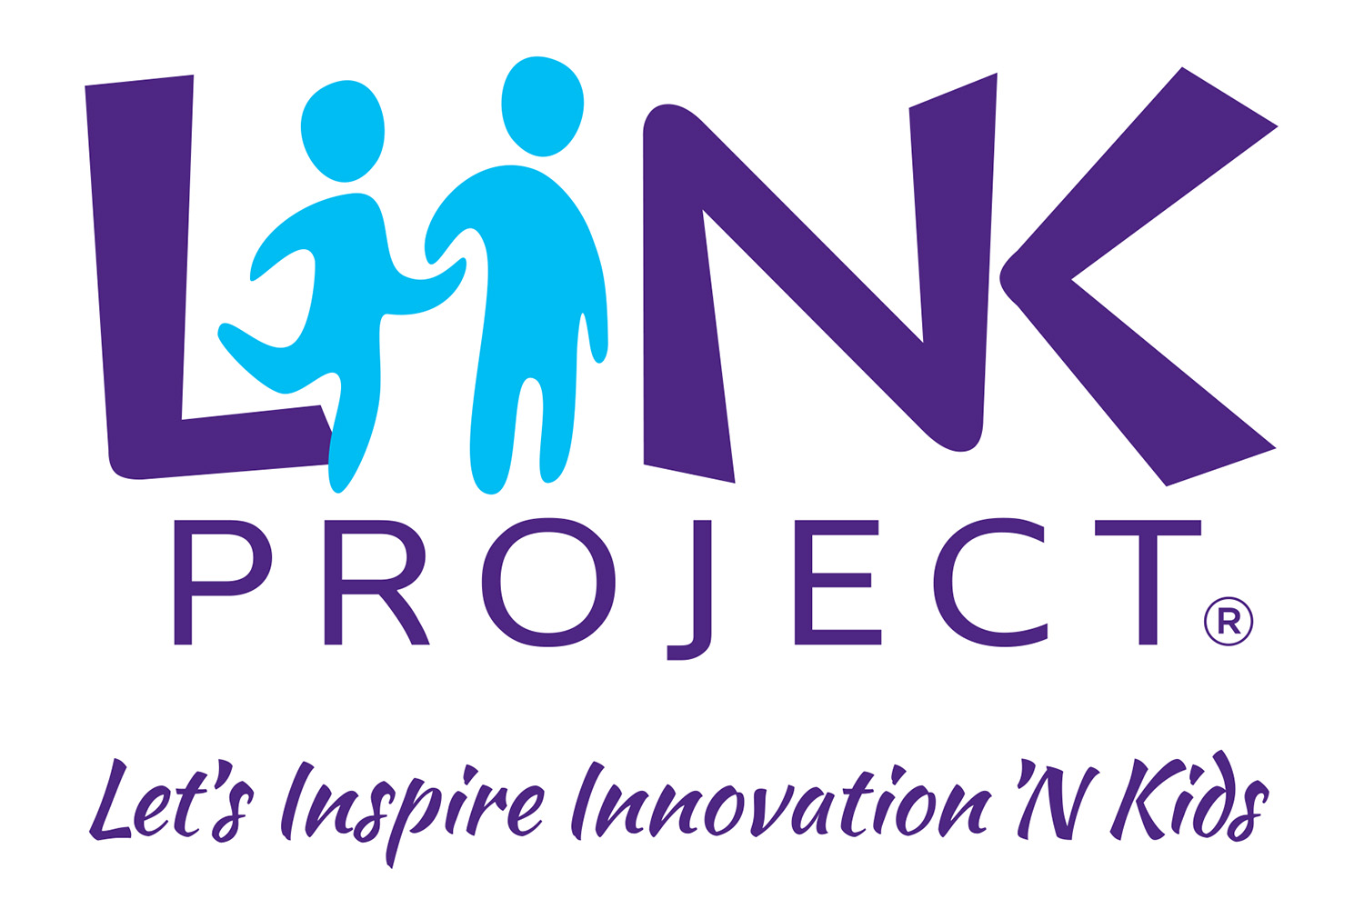
LiiNK break Essential for Everyone
Schedule breaks (intentional)
Set a timer
Unplugged
Outdoors
Look around/release the tension
Deep breathing

Slide 15
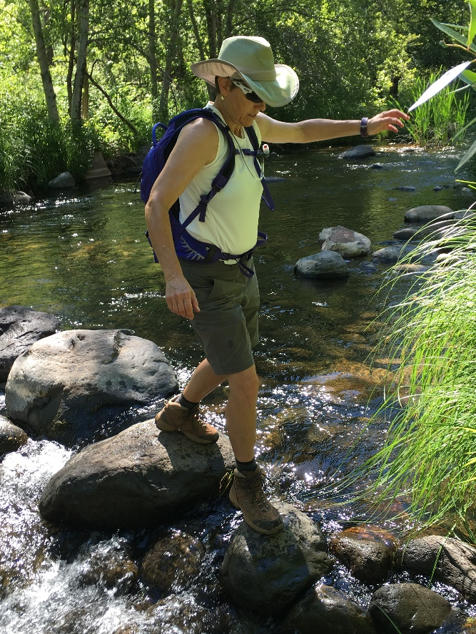
Healthy Outdoor environments

Slide 16
Loose Parts Suggestions for Kids
Hula hoops
Plastic connecting pipes/pieces
Mesh Frisbees
Jump ropes
Crawl-through tunnels
Buckets
Sand/Shovels/scoops
Pool noodles
Cardboard boxes
Music
Pots, pans, utensils, small hibachi type grill
Odds & ends tools; nuts & bolts; small wood boards
Puppets (sock puppets great option!)
Clothing, hats, shoes for make believe
Bubbles, playdough, chalk
Legos, blocks

Slide 17
Making unstructured play a priority takes intentional planning
What is one thing you, your school, or your work place can do right now to bring play/breaks into the day?
Notes:
All give input.

Slide 18
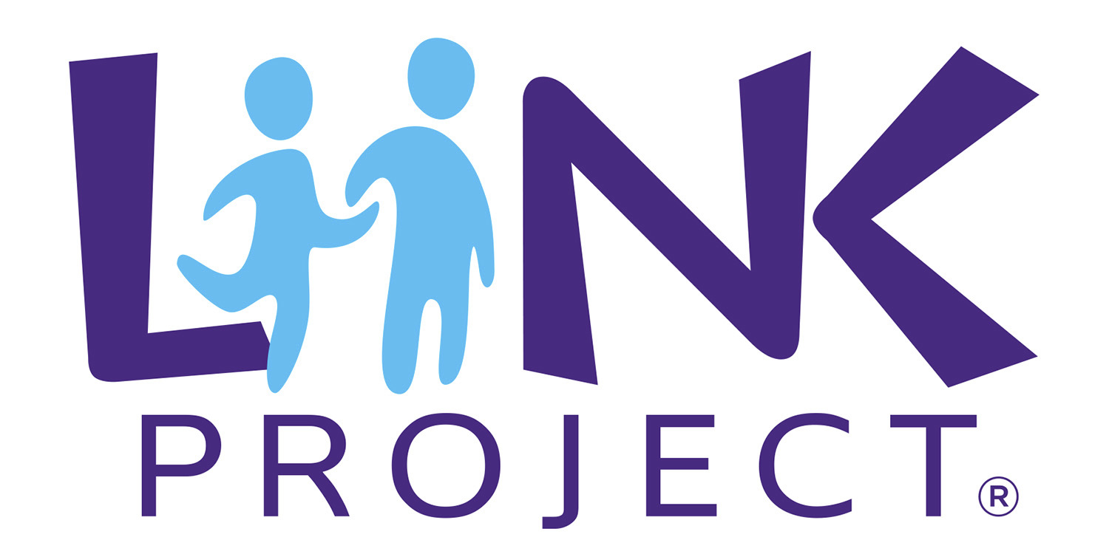
Thank-You!
www.facebook.com/theliinkproject
www.liinkproject.tcu.edu
@tculiink
@tculiink
d.rhea@tcu.edu
Notes:
LM
New website is live, now one insta and twitter, promote book?, newsletter
Any new materials we have out will be on the website, include book

