Slide 1
Unstructured, Outdoor Play in Schools – Working Smarter Together
Dr. Deborah J Rhea
Professor, Kinesiology
LiiNK Center for Healthy Play – Director
Texas Christian University
Founding Member – Global Recess Alliance

Slide 2
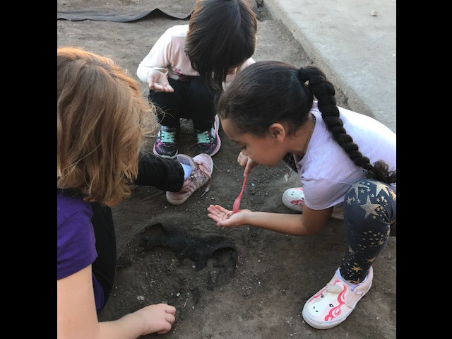
Children learn how to learn through play
1910
2022

Slide 3
Goals for today
LiiNK results for the past eight years
How to combat roadblocks
Policies we need to work on together to put play back in the child’s life

Slide 4
State of the Nation
10-20 million children and adolescents in the United States have some form of chronic illness or disability
133 million (45%) adults have at least one chronic illness
18-22% of children & adolescents are obese; 40% overweight/obese
69% of our nation’s adults are overweight or obese
D3 deficiencies as early as 1-6 months through older adults
Sedentary lifestyle is common in children and adults
Stress and anxiety disorders are at an all time high (31.9% in adolescents; 1 out of 7 children)
Anxiety is the most common mental disorder, affecting 40 million adults in the U.S. population
Indoors at least 6 hours per school day (9 mos of year)
Socialization is minimal
Technology addictions (37% teens; 330 million adults)

Slide 5
Educational Challenges Post-COVID
Standardized tests
Hasn’t changed
01
Lack of resilience and social skills
+ trauma, abuse, Neglect
02
Unhealthy –
More so
03
Online school Push
04
U.S.Play Coalition Conference 2022

Slide 6
What’s Missing?

Slide 7
Nature Deficit Disorder
Target Focused vs Field Focused (ADHD)
Stress response – relaxed state
Hormone: D3
Eyes/colors
Weather variety – fresh air

Slide 8
D3
What is it & Why do we need it
Hormone that needs the sun
Immune system builder
Stress reducer
Fights chronic diseases
How do we get it naturally?
From the sun
Best time – 10-2
15-20 minute segments
All weather conditions
Best location - Between elbow and wrist

Slide 9
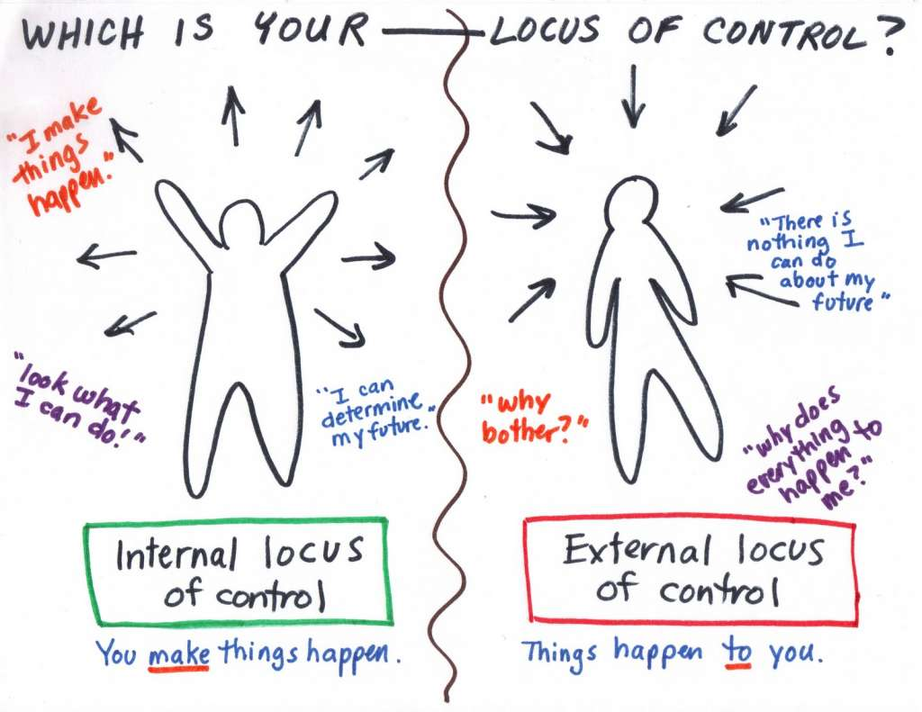
Locus of Control

Slide 10
Our mission is to bridge the gap between academics and social, emotional, and healthy well-being.
We develop the whole child through 60 minutes of recess and 15-minute character development lessons daily

Slide 11
LiiNK Results

Slide 12
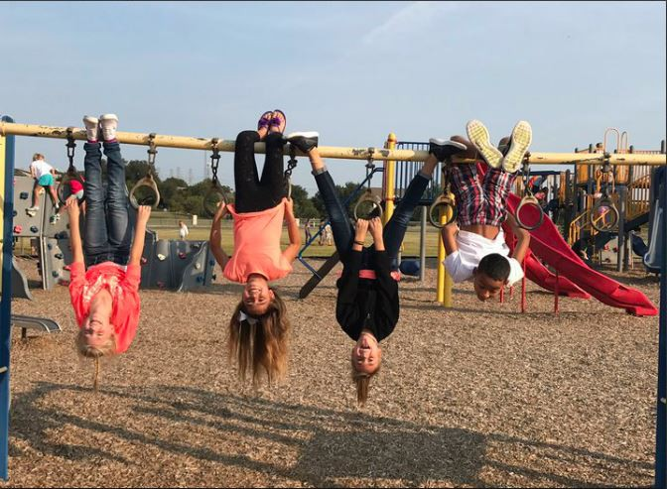
LiiNK schools:
60 minutes of outdoor, unstructured play daily
Not removed for punishment or tutoring
Control Schools:
15-30 minute recesses daily
Less recess due to weather (LiiNK 13 TO 103) and tutoring/discipline issues
Notes:
Character lessons include: TRUST, RESEPCT,HONESTY, EMPATHY, CONFIDENCE, SELF-ESTEEM

Slide 13
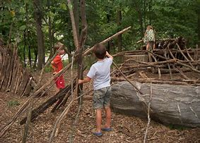
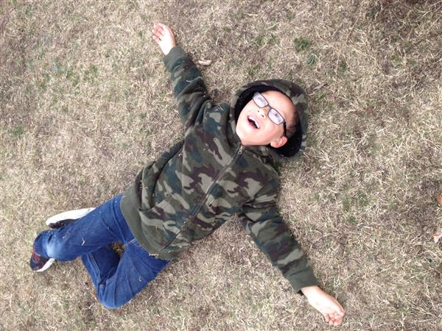
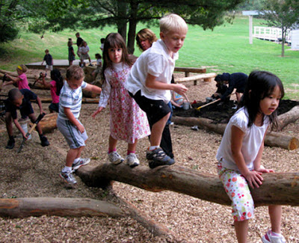
Properties of Child’s play
Purposeful
Self-directed
Voluntary
Inherent attraction
Freedom from time
Diminished consciousness of self
Improvisational potential
Continuation desire

Slide 14
LiiNK break in schools
Timer
Unplugged
Outdoors
Bathroom on the way out
15 minutes each time – starts at the exit door; ends on the playground
Reminders of what to do when re-entering classroom

Slide 15
Sample Schedule Professional Development 9:00-9:45 Break 10:00-10:45 Break 11:00-11:45 Lunch 12:45-1:30 Break 1:45-2:30 Break 2:45-3:30

Slide 16
Synchronize your phones 9:45 10:45 1:30 2:30

Slide 17
Off-Task Behaviors 2014-present
Off-task behaviors significantly decreased in intervention schools compared to control schools
No gender or grade level differences among intervention students
Creativity is improved through multiple recesses
Bullying decreases on the playground at intervention schools
Socialization significantly improved between students at intervention schools

Slide 18
Attentional Focus
Ability to attend in class significantly improved
Transition from recess to classroom creates better focus
Grade level does not predict attentional focus when multiple recesses are scheduled
Important content can be taught in the morning or afternoon

Slide 19
Body Fat % Change in one year – 60 minutes of recess

Slide 20
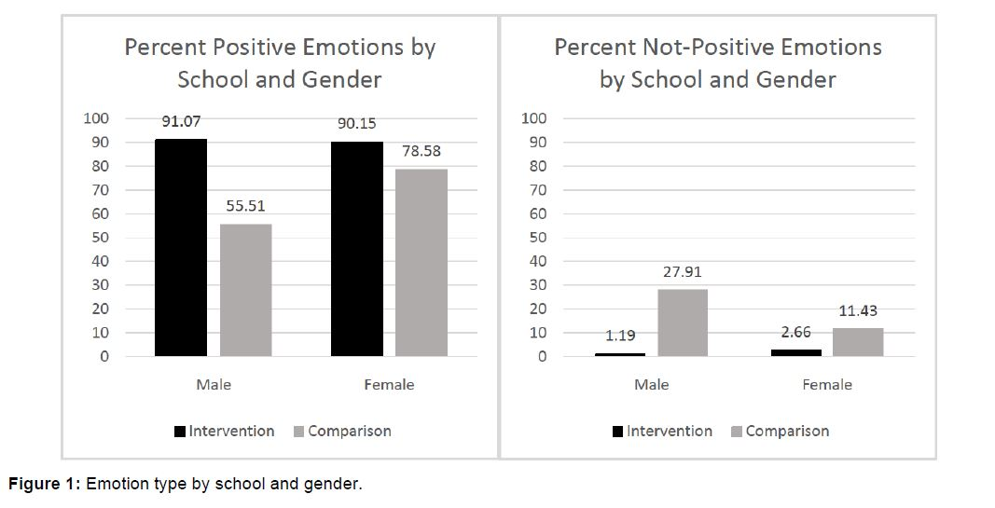
Positive Emotions – Not Positive Emotions

Slide 21
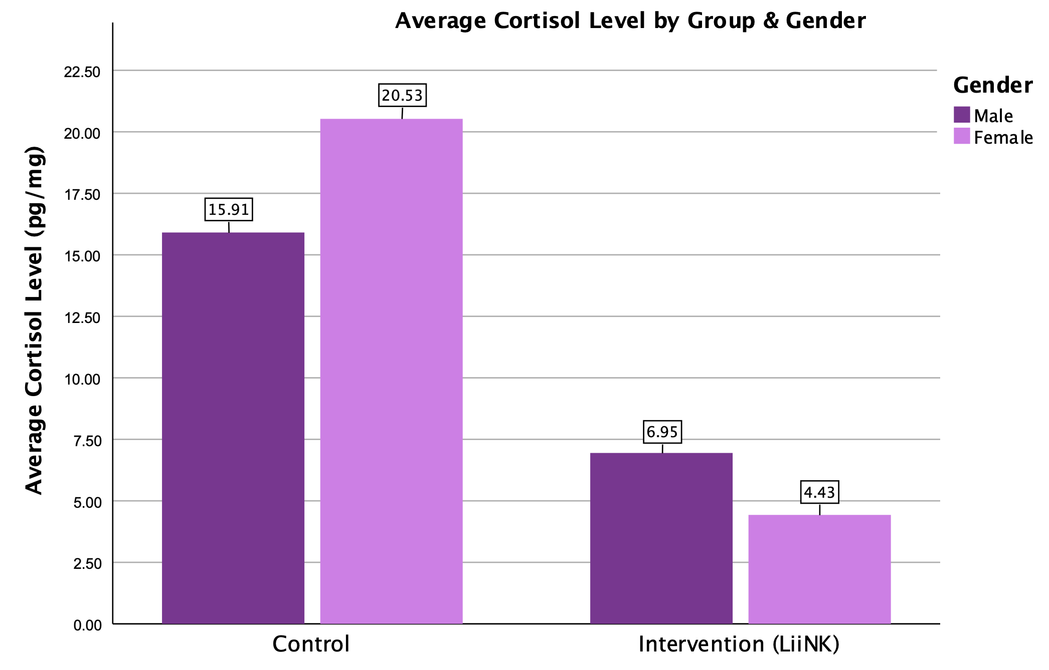
Stress/Anxiety Cortisol Levels During COVID Aug-Nov 2021
N=64 (C)
N=66 (I)
Cortisol Natl Avg :
9 yrs=6.7mg
10yrs=8.5mg
LiiNK Males 6.95
LiiNK Females 4.43
Control Males 15.91
Cotrol Females 20.53
Figure 1

Slide 22
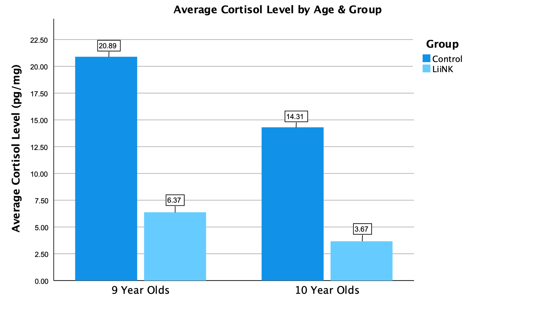
Stress/Anxiety Cortisol Levels After COVID August-November 2021
N=64 (C)
M=35
F=29
N=66 (I)
M=31
F=35
Cortisol Natl Avg
9 yrs=6.7mg
10yrs=8.5mg

Slide 23
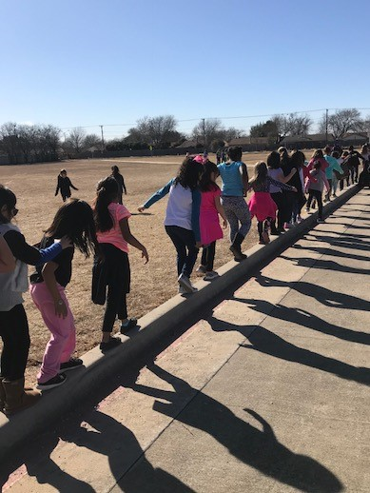
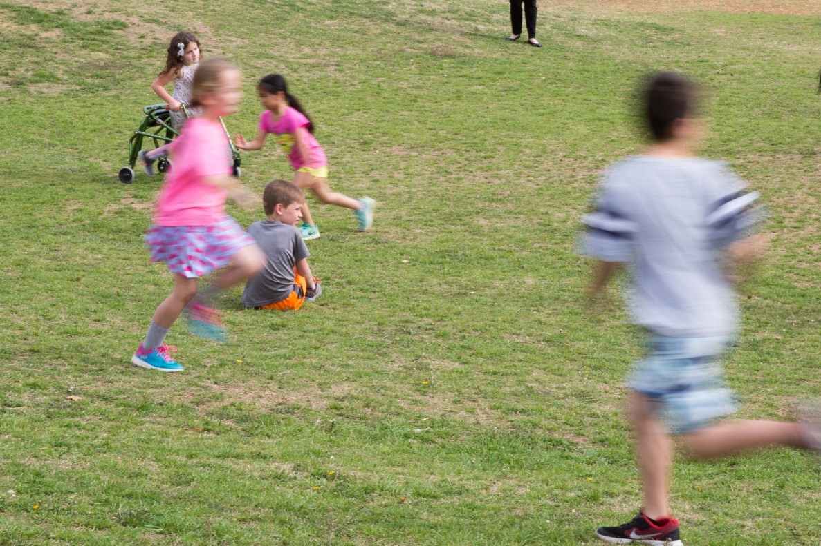
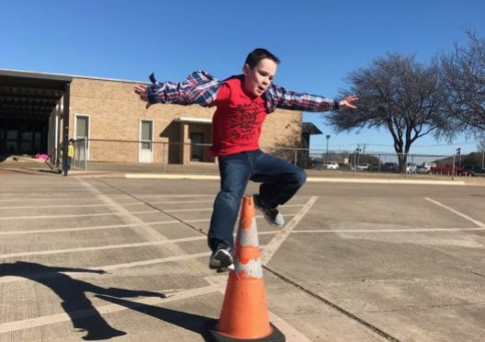
Play Promotes Gross Motor Skills

Slide 24
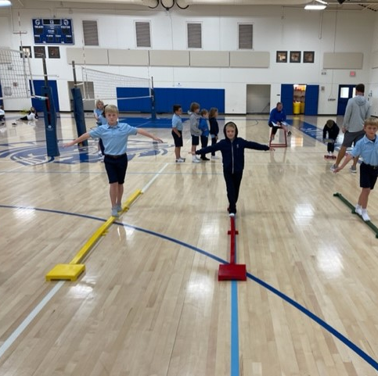
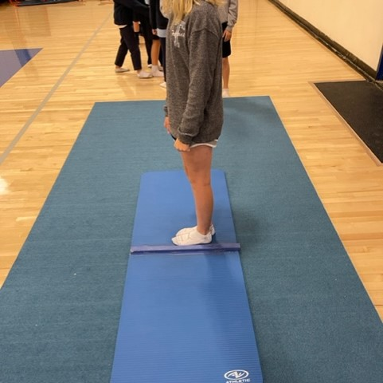
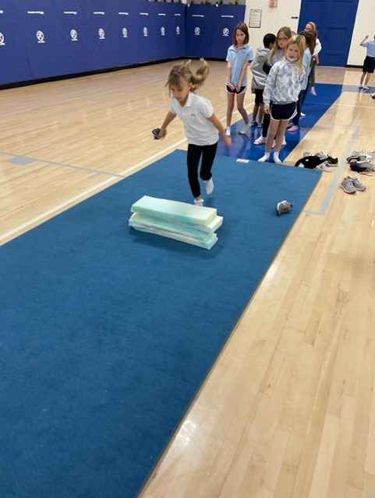
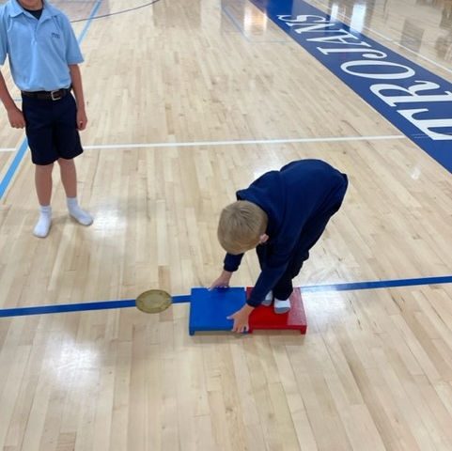
KTK: Assessing Postural Balance and Motor Competence
Single Leg Hop
Sideways Step
Lateral Jump
Balance Beam

Slide 25
Intervention vs. Control

Slide 26
Sex Differences
***=p<.001, **=p<.01

Slide 27
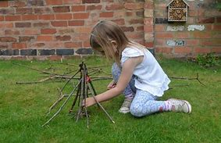
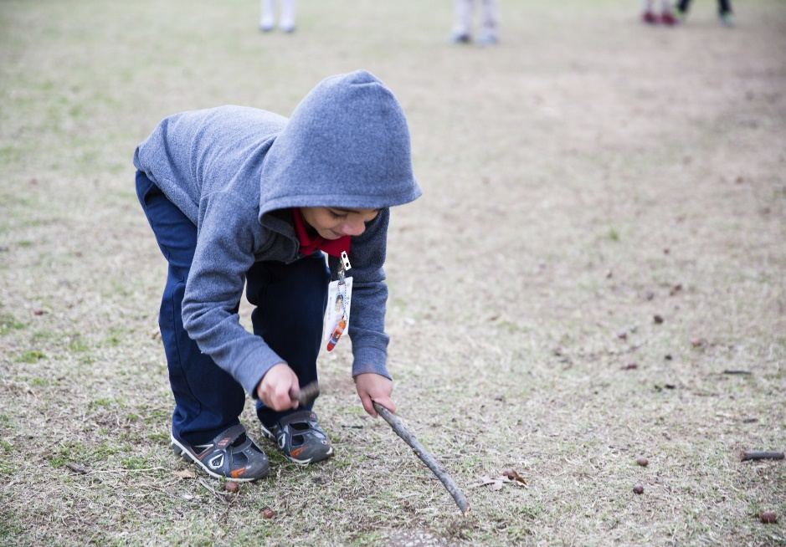
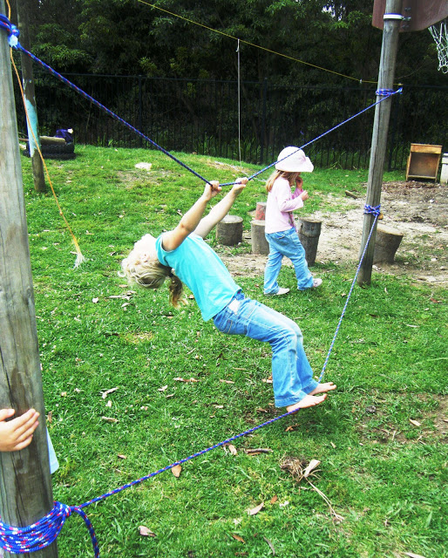
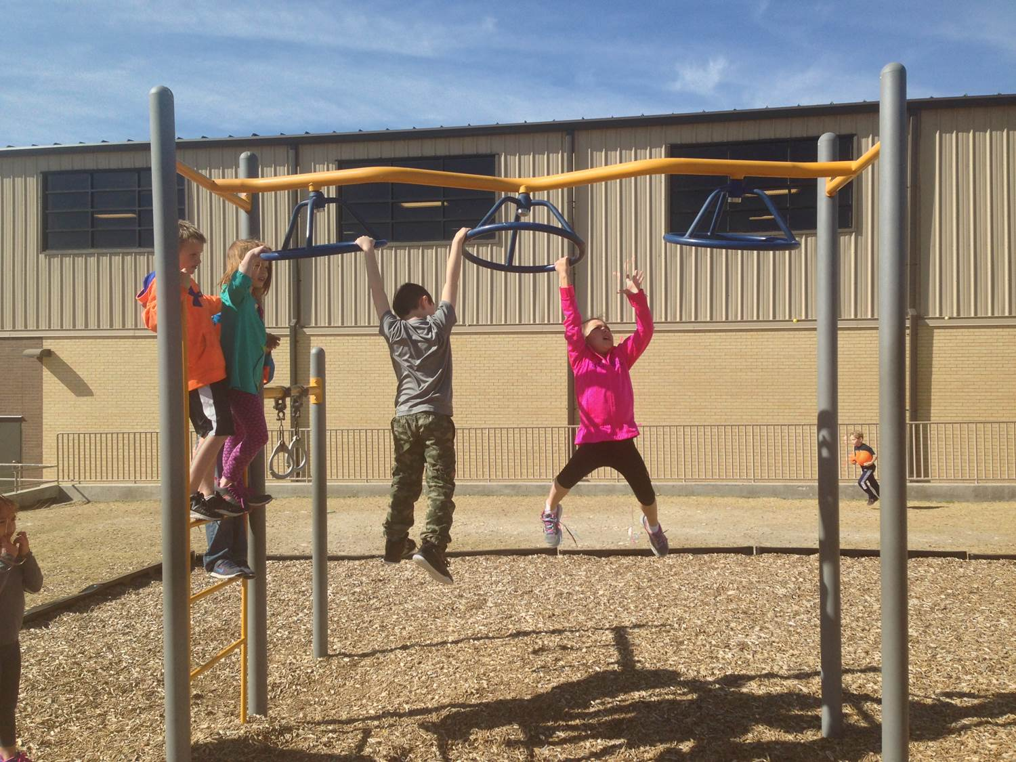
Play Promotes Fine Motor Skills
Notes:
DO:
[Discuss each of the pictures shown.]
[Relate a story.]
SAY:
Here we see unstructured play in natural environments. These pictures are from different places.
On the far right, you see a picture of Finland. Notice its different kind of landscape.
Can you see kids playing here?
In the center, you see a LiiNK school.
How many kids do you see in the tree?
How many times do we see this today?
How uncomfortable are you seeing this?
How do you feel about kids climbing up there?
Remember with LiiNK, safety is first! We will talk about that later. But this tree is older so it has a sturdy trunk, and the kids aren’t that high up in it. Also, landing surface is very important.
On the left, you’ve got two more pictures of unstructured play in LiiNK schools.
Tell a story about a time children were being creative in an unstructured environment.
BACKGROUND INFO:
Story example:
You’ll learn that with LiiNK, no balls are allowed on the playground. This encourages children to be creative without playing sports. Sometimes they are uncomfortable at first, but you’ll notice they start to play their own games. A favorite story of mine is watching the children act like puppies, with one mama puppy, crawling around in the grass on all fours and barking. This is their time.

Slide 28
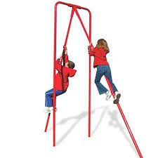
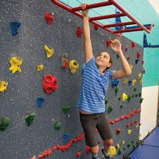
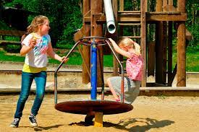
Unilateral
Movement Patterns

Slide 29
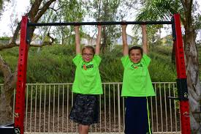
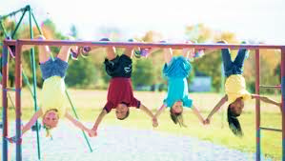
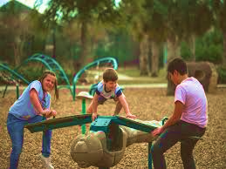
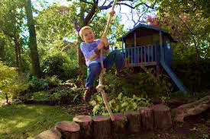
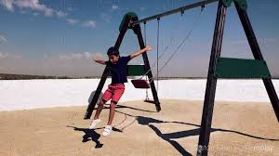
Movement Patterns
Bilateral

Slide 30
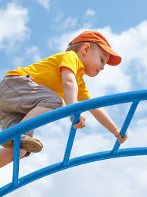
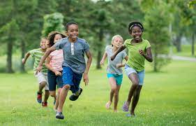
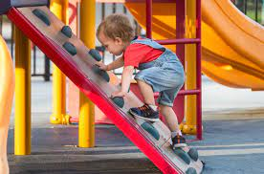
Movement Patterns
Contralateral

Slide 31
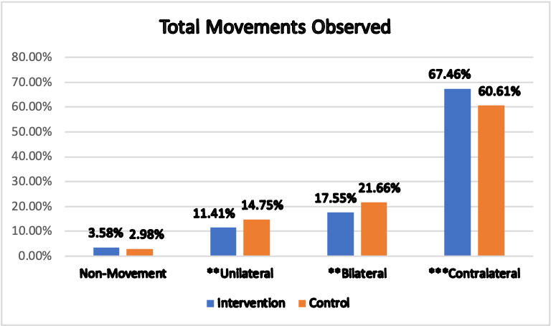
RESULTS
*
*
*P = 0.05, **P < 0.01, ***P< 0.001
Notes:
*P = 0.05, **P < 0.01, ***P< 0.001
Non: P= 0.3594
Uni: P= 0.0069
Bi: P= 0.0047
Contra: P= 0.00009

Slide 32
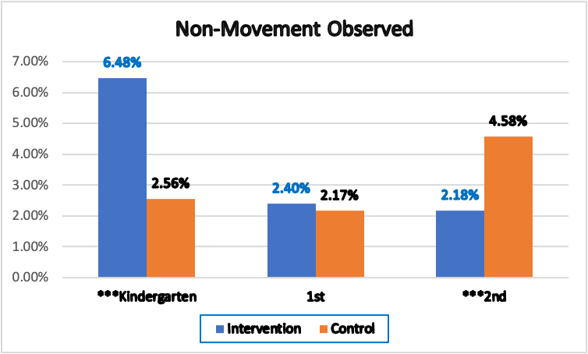
RESULTS
*P = 0.05, **P < 0.01, ***P< 0.001
Notes:
K: P= 0.000001
1st: P= 0.6727
2nd P= .0002

Slide 33
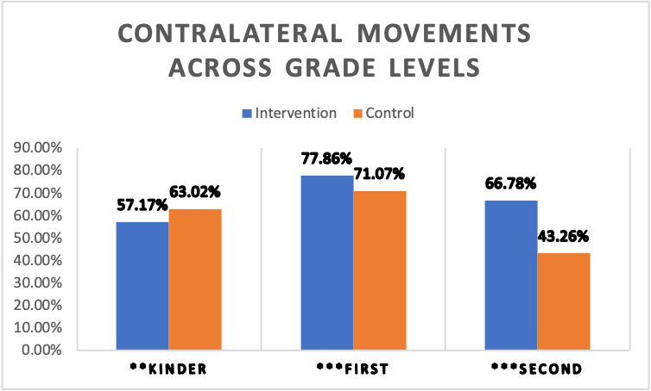
RESULTS
*P = 0.05, **P < 0.01, ***P< 0.001
Notes:
Kinder: P= .0011
1st: P= .00002
2nd: P= .000001

Slide 34
LiiNK Teacher/Parent/Child quotes
Teacher: “This is a way of thinking for them and us.”
Teacher: “I didn’t realize how much we needed these outdoor play breaks too.”
Student: “When are we going to use the clip chart.” Teacher response: “When we need it.”
“The students seem tidier.”
Child at home to mother: “How can I help you? Father to mother: “Give her a list.”
Child to sibling: “You have a negative self-concept.”

Slide 35
LiiNK® Result Summary
Only takes one day to play independently
Children run, chase, roll, jump, climb, and swing
Play differently
Socialize differently
They are happy & less anxious
Don’t need massive equipment
Need hills, water, sand, and natural equipment such as trees, stumps, and beams
Teachers need breaks too

Slide 36
Teacher Roadblocks
TiME
01
Required Minutes
Recess isn’t included
02
Curriculum
Changes
yearly
03

Slide 37
School District Roadblocks
Lack of consistency
01
Required Minutes
Recess isn’t included
02
Discipline issues
(Trauma Induced)
03

Slide 38
Three Pillars of Traumawise Care
82
Notes:
Howard Bath’s research around what is required for heling children heal from trauma
Connection is in the center because you cannot feel safe or self-regulate when attachment is has broken down
Felt Safety- knowing you're safe for yourself and within yourself both psychologically and physically
Self- Regulation- the ability to calm myself

Slide 39
Willful Disobedience
ADULT
Power Struggles
CHILD
Increase
Resistance
Increase
Frustration
Oppositional
Behaviors
Enforces
More Rules
Social
Problems
Downward Spiral
130

Slide 40
Survival Behavior
ADULT
Felt Safety
CHILD
Reduced
Frustration
Awareness
Compassionate
Understanding
Recognize
Fear
Manipulation
Triangulation
Aggression
Control
Violence
Give Voice
Use Words
Upward Spiral
130

Slide 42
What are policies that will influence school decision makers to include play breaks in spite of standardized test score deficits?

Slide 43
Recess Policies District Content Requirement Policies State Content Requirement Policies community projects – get kids involved

Slide 44
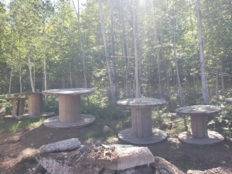
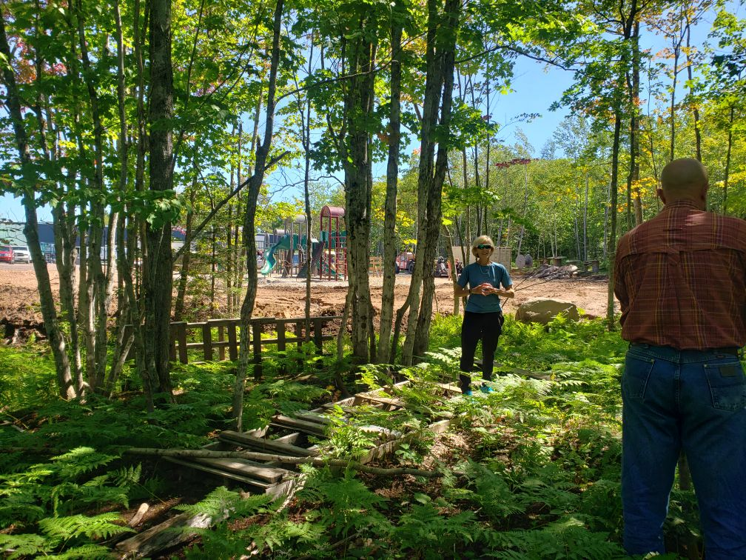
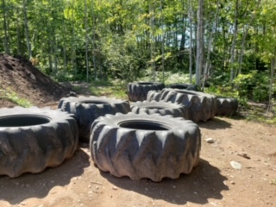
Recess Policies
No recess policy has all of these items
Michigan Charter School is following these principles
Unstructured, outdoor play (recess)
Each recess should be 15 minutes at least twice daily
Cannot remove for punishment or tutoring
Recess should count as content minutes
Recess minutes should be separate from physical education minutes

Slide 45
Lack of Loose Parts for Kids
Hula hoops
Plastic connecting pipes/pieces
Mesh Frisbees
Jump ropes
Crawl-through tunnels
Buckets
Sand/Shovels/scoops
Pool noodles
Cardboard boxes
Music
Pots, pans, utensils, small hibachi type grill
Odds & ends tools; nuts & bolts; small wood boards
Puppets (sock puppets great option!)
Clothing, hats, shoes for make believe
Bubbles, playdough, chalk
Legos, blocks

Slide 46
District & State Considerations
Require play breaks every 60-90 minutes in Inservice/Professional Development Trainings
Keep good leadership at schools
Cross-curricular teaching
Stick with curriculum so it can work
Less school per day (quality vs quantity)
Minimize assessments to prepare for a standardized test
Education agencies need to give local control more decisions
State bills need to have resources to support school districts
Ask the question – why are teachers leaving in the middle of the school year?

Slide 47
Community Projects

Slide 48
Who are more open to your message for play in schools?
Forward thinkers
Those willing to step out on a limb
Those who believe in play

Slide 49
Making unstructured play a priority takes intentional planning
What is one thing you, your school, or your work place can do right now to bring play/breaks into the day?
Notes:
All give input.

Slide 50
Start early, Never quit Start lateR, stay with it

Slide 51
www.liinkproject.tcu.edu

Slide 52
Thank-You!
www.facebook.com/theliinkproject
www.liinkproject.tcu.edu
@tculiink
d.rhea@tcu.edu
@tculiink
Notes:
LM
New website is live, now one insta and twitter, promote book?, newsletter
Any new materials we have out will be on the website, include book

